Slide 1
Computational Modelling of Social Systems Modelling Segregation Week 2
Ana Jaramillo, Pavle Savković
Graz
12.03.2025

Slide 2
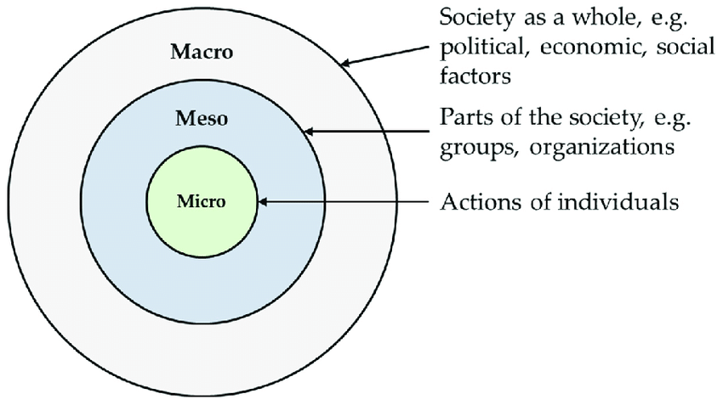
Recap
ABM is a computational tool that allows us to simulate the micro-level behavior of agents in simple societies and observe the macro-level outcome. This allows us to draw a causal link between micro to macro.

Slide 3
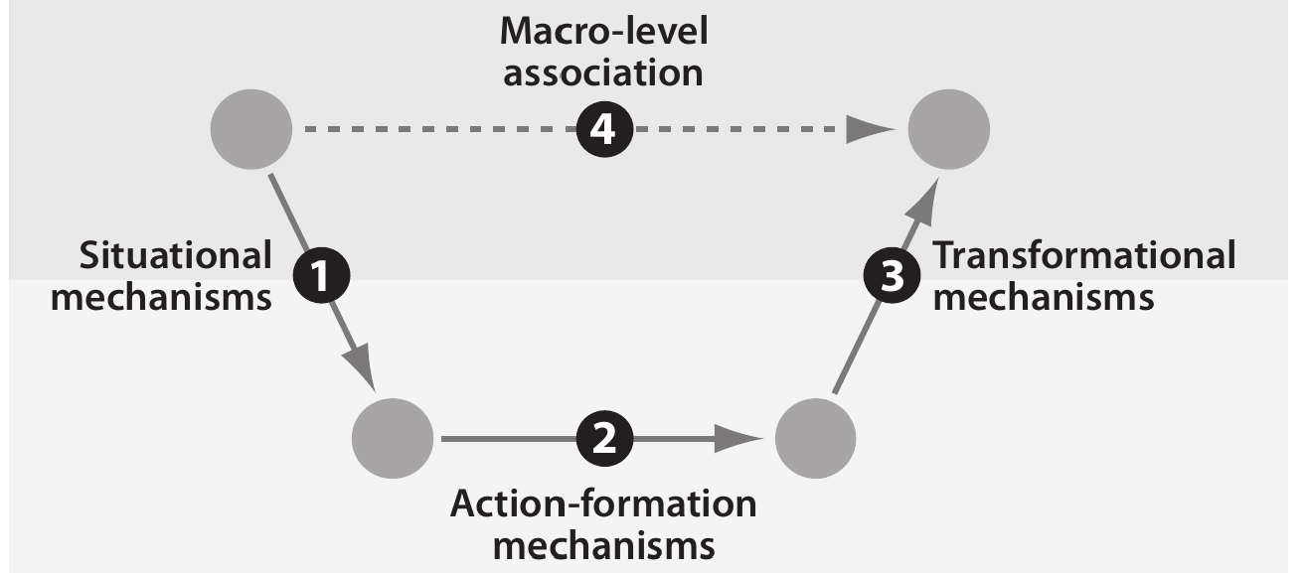
The micro-macro gap
Causal Mechanisms in the Social Sciences. Peter Hedström and Petri Ylikoski. Annual Review of Sociology, 2010.
Notes:
A basic point of the mechanistic perspective is that explanations that simply relate macro properties to each other (arrow 4) are unsatisfactory. These explanations do not specify the causal mechanisms by which macro properties are related to each other. Deeper explanatory understanding requires opening up the black box and finding the causal mechanisms that have generated the macro-level observation. Rather than analyzing relationships between phenomena exclusively on the macro level, one should identify the situational mechanisms by which social structures constrain individuals’ action and cultural environments shape their desires and beliefs (arrow 1), describe the action-formation mechanisms according to which individuals choose how to act (arrow 2), and single out transformational mechanisms by which individuals, through their actions and interactions, generate various intended and unintended social outcomes (arrow 3). Only by understanding the whole chain of situational, action- formation and transformational mechanisms, have we made sense of the observed macro- level relationship

Slide 4
Beyond exploration: computational theory and framing
ABM are for analysis, not just exploration
Exploring what happens in a simulation is fine, but ABM can do much more!
Behavior calibration of individual agents with experiments or surveys: integrating social and behavioral findings in an ABM.
Analysis of observable outcomes versus parameters of behavior or alternative mechanisms/policies
Testing outcomes with large-scale data (e.g. digital traces from computational social systems), across conditions and over time
From factors to actors: Computational Sociology and Agent-Based Modeling. Michael Macy and Robert Willer. Annual Review of Sociology, 2002.
Notes:
We can examine various hypothetical scenarios; what happens if we have agents behaving in different ways, how that affect the outcome. It is also important these days because it allows us to study scenarios that might happen but has not happen in society. Example of COVID-19

Slide 5
Properties of good ABM
They model causation: agent actions and conditions have counterfactuals, and dynamics are not ad hoc to get an outcome.
They have measurable outcomes: collective behavior can be aggregated into one or more quantities that can be measured in many simulations and across conditions.
They have quantifiable designs: individual dynamics are based on metrics that can be tested with empirical methods (e.g. experiments, surveys)
Are minimal and modular: you can test the sensitivity of outcomes with different blocks of dynamics and include only what is necessary.
Ockham’s razor principle: if you have two competing ideas to explain the same phenomenon, you should prefer the simpler one.
Stochasticity, randomness, and path-dependencies are considered.

Slide 6
Overview of today’s lecture
1. Segregation
2. Schelling's segregation model
3. Analyzing Schelling's model
4. Cellular Automata: The game of life
Notes:
We will talk about segregation; how to model it and also another types of models such as Game of Life

Slide 7
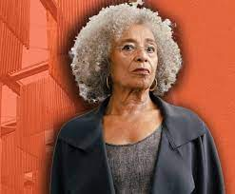
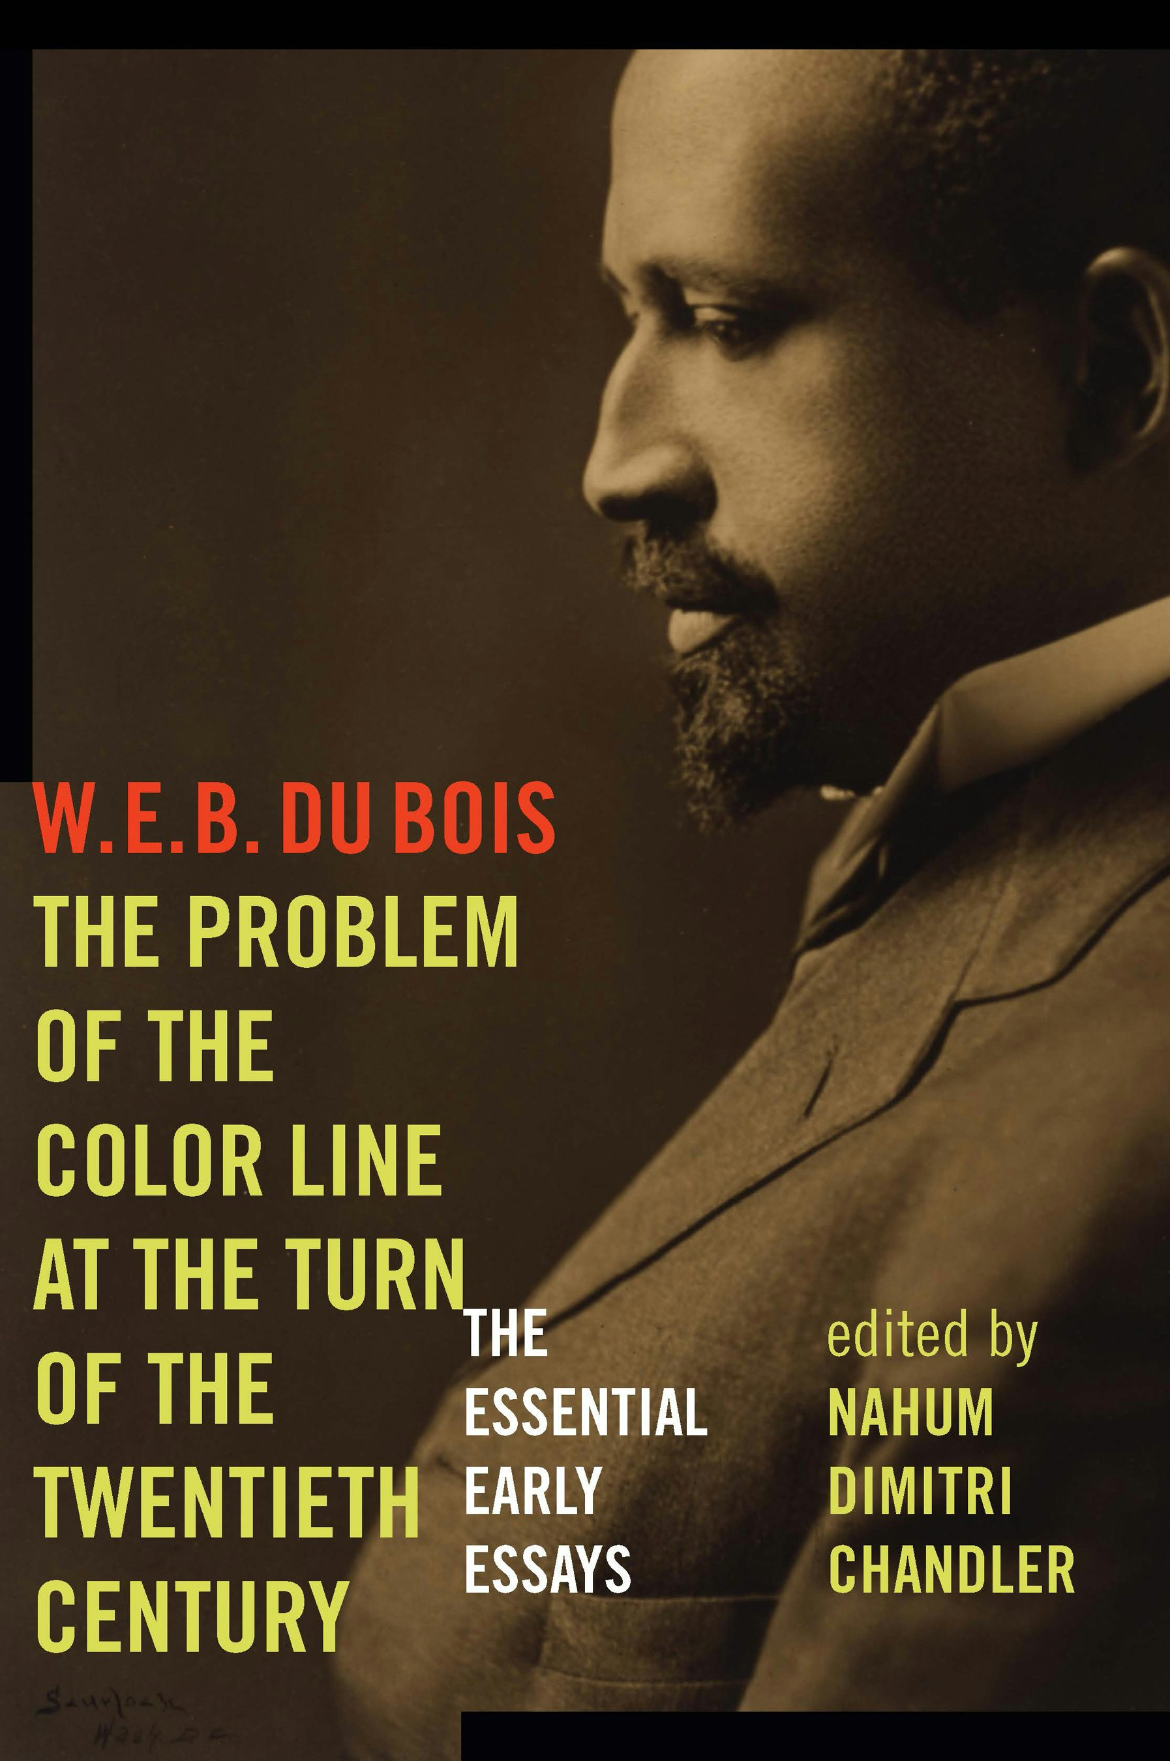
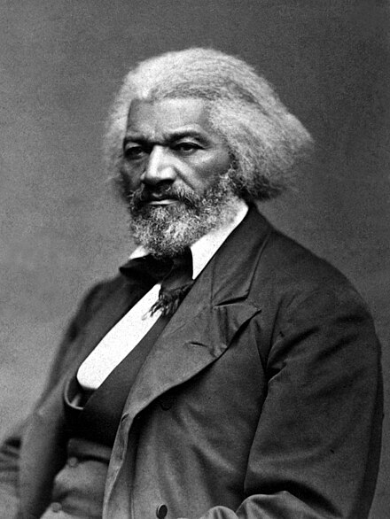

The study of segregation by African-american scholars
Frederick Douglass
1881
1903
1981

Slide 8
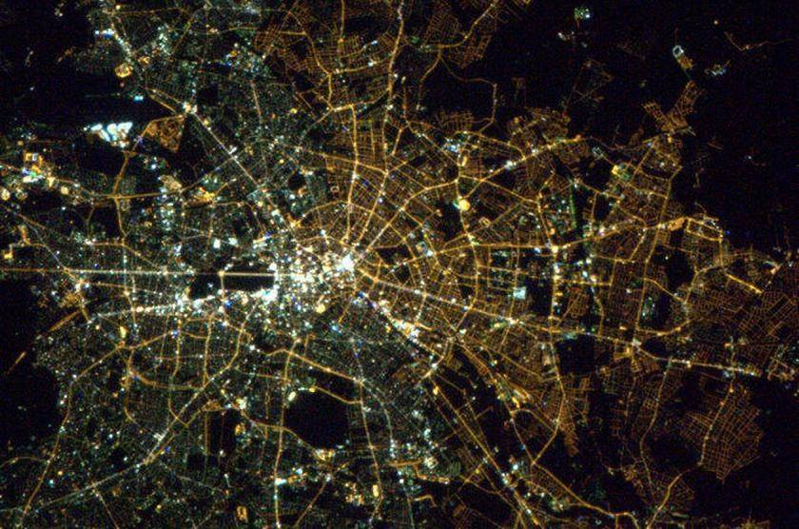
Urban segregation: definition
Urban segregation is the unequal distribution of different social groups in the urban space, based mainly on occupation, income and education, as well as on gender and ethnicity. -- The Future of Cities. European Research Commission
Notes:
Which city is it? A tip for those students who are from Germany? Berlin at night. /poverty if Africa
You can quite clearly see the, color divide of the light´s down the middle, west Berlin being the whiter lights, and east Berlin being the yellow lights.
That’s because the majority of the streetlights on each side were installed before the wall came down and appear as different colors due to the bulbs’ chemical makeup.
They found a few surprises: US cities, for instance, are many times brighter than German cities of similar size. And, intriguingly, East Berlin appears to emit more light per capita than its wealthier counterpart in the West. Technology, culture, lighting codes, and even the way cities array their streets all seem to have a big impact.

Slide 9
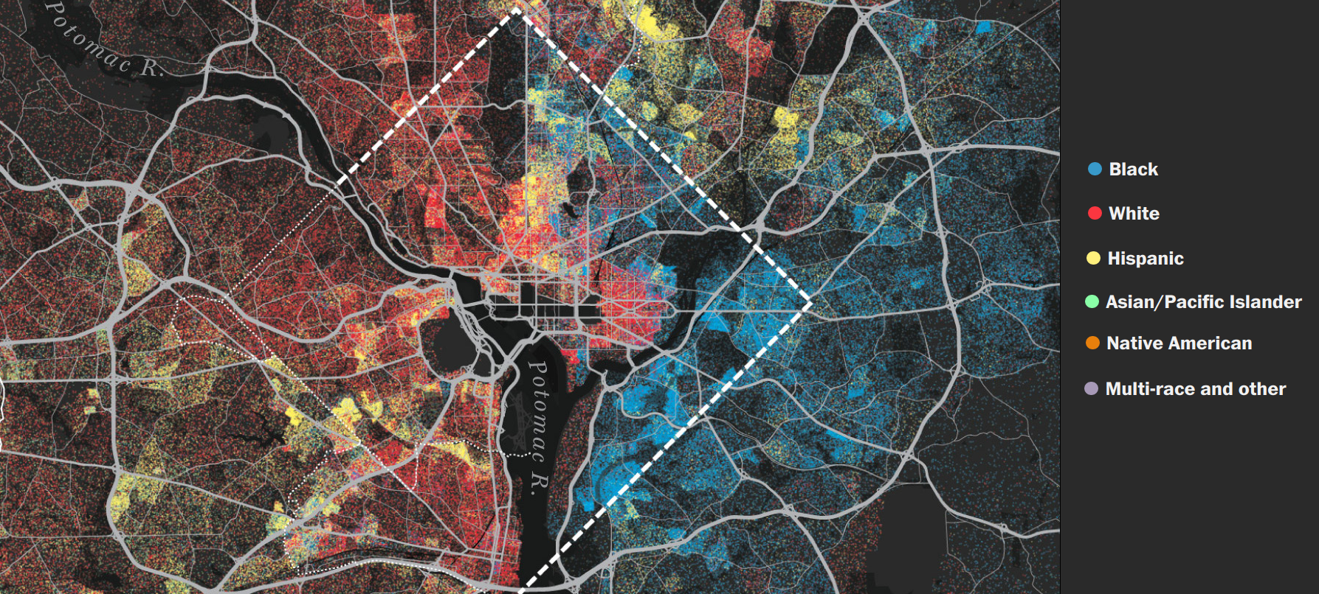
Segregation example: District of Columbia, US
America is more diverse than ever — but still segregated. The Washington Post
Notes:
Spend some time with students explore racial divides
https://www.washingtonpost.com/graphics/2018/national/segregation-us-cities/

Slide 10
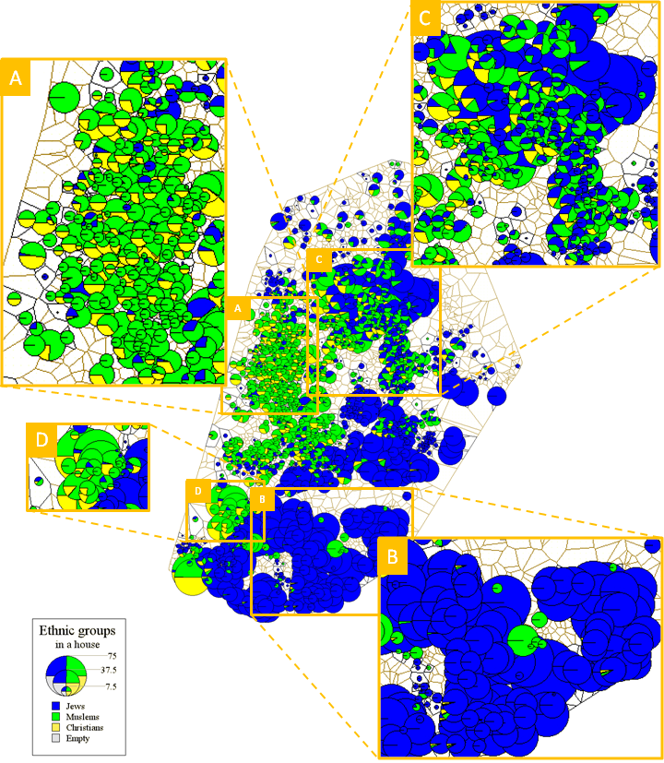
Segregation example: Yaffo, Israel
Neighborhood units with shares of ethnic groups as pie charts
Share of Jewish, Muslim, and Christian inhabitants
Segregation: Jewish vs Muslim areas
Observation: some areas are less segregated (area C)
Hatna & Benenson. JASSS, 2012
Notes:
What do you see in reiugon A
What do you see in region B
Do we have a region that is diverse among those that are zoomed in?

Slide 11
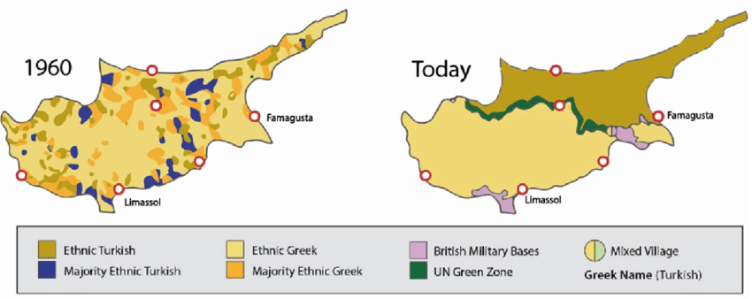
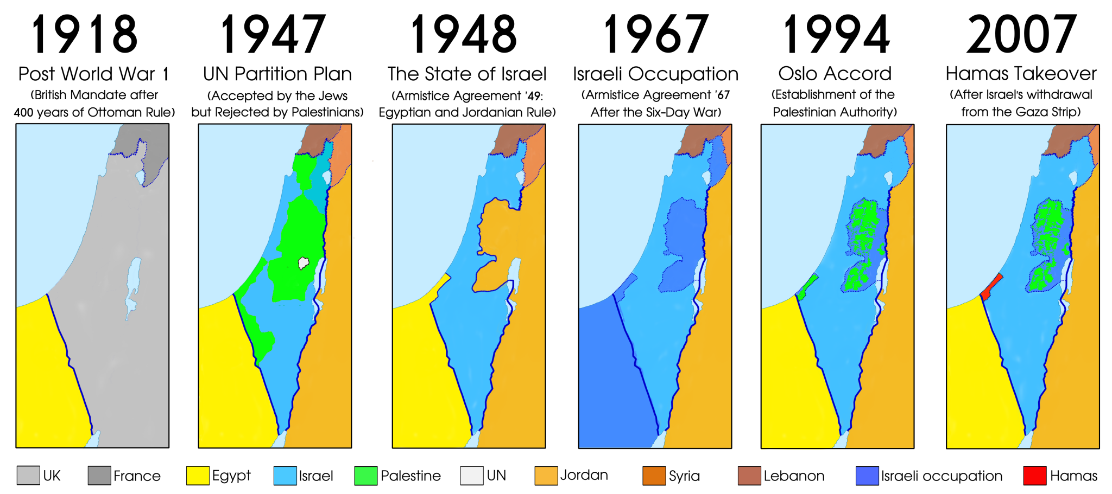
Segregation in macro scale explained by governmental decisions
Cyprus
Palestina
[1] Husain, Husam & Nafa, Hassina. (2020). [2] Beyond the headlines: Understanding the Israeli-Palestinian Conflict

Slide 12
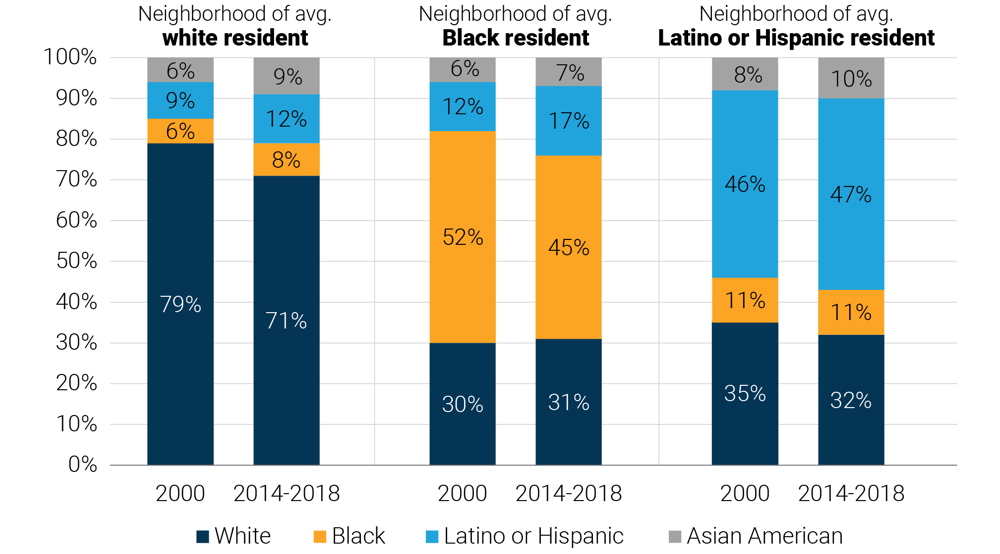
Residential segregation persistence
The Great Real Estate Reset. Loh, Coes, & Buthe, 2020

Slide 13
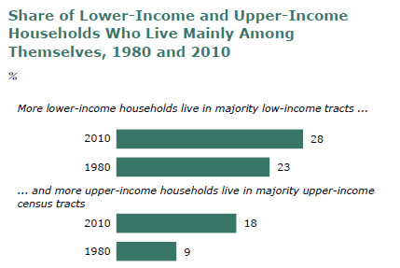
Increasing income segregation
The Rise of Residential Segregation by Income. Pew Research Center.

Slide 14
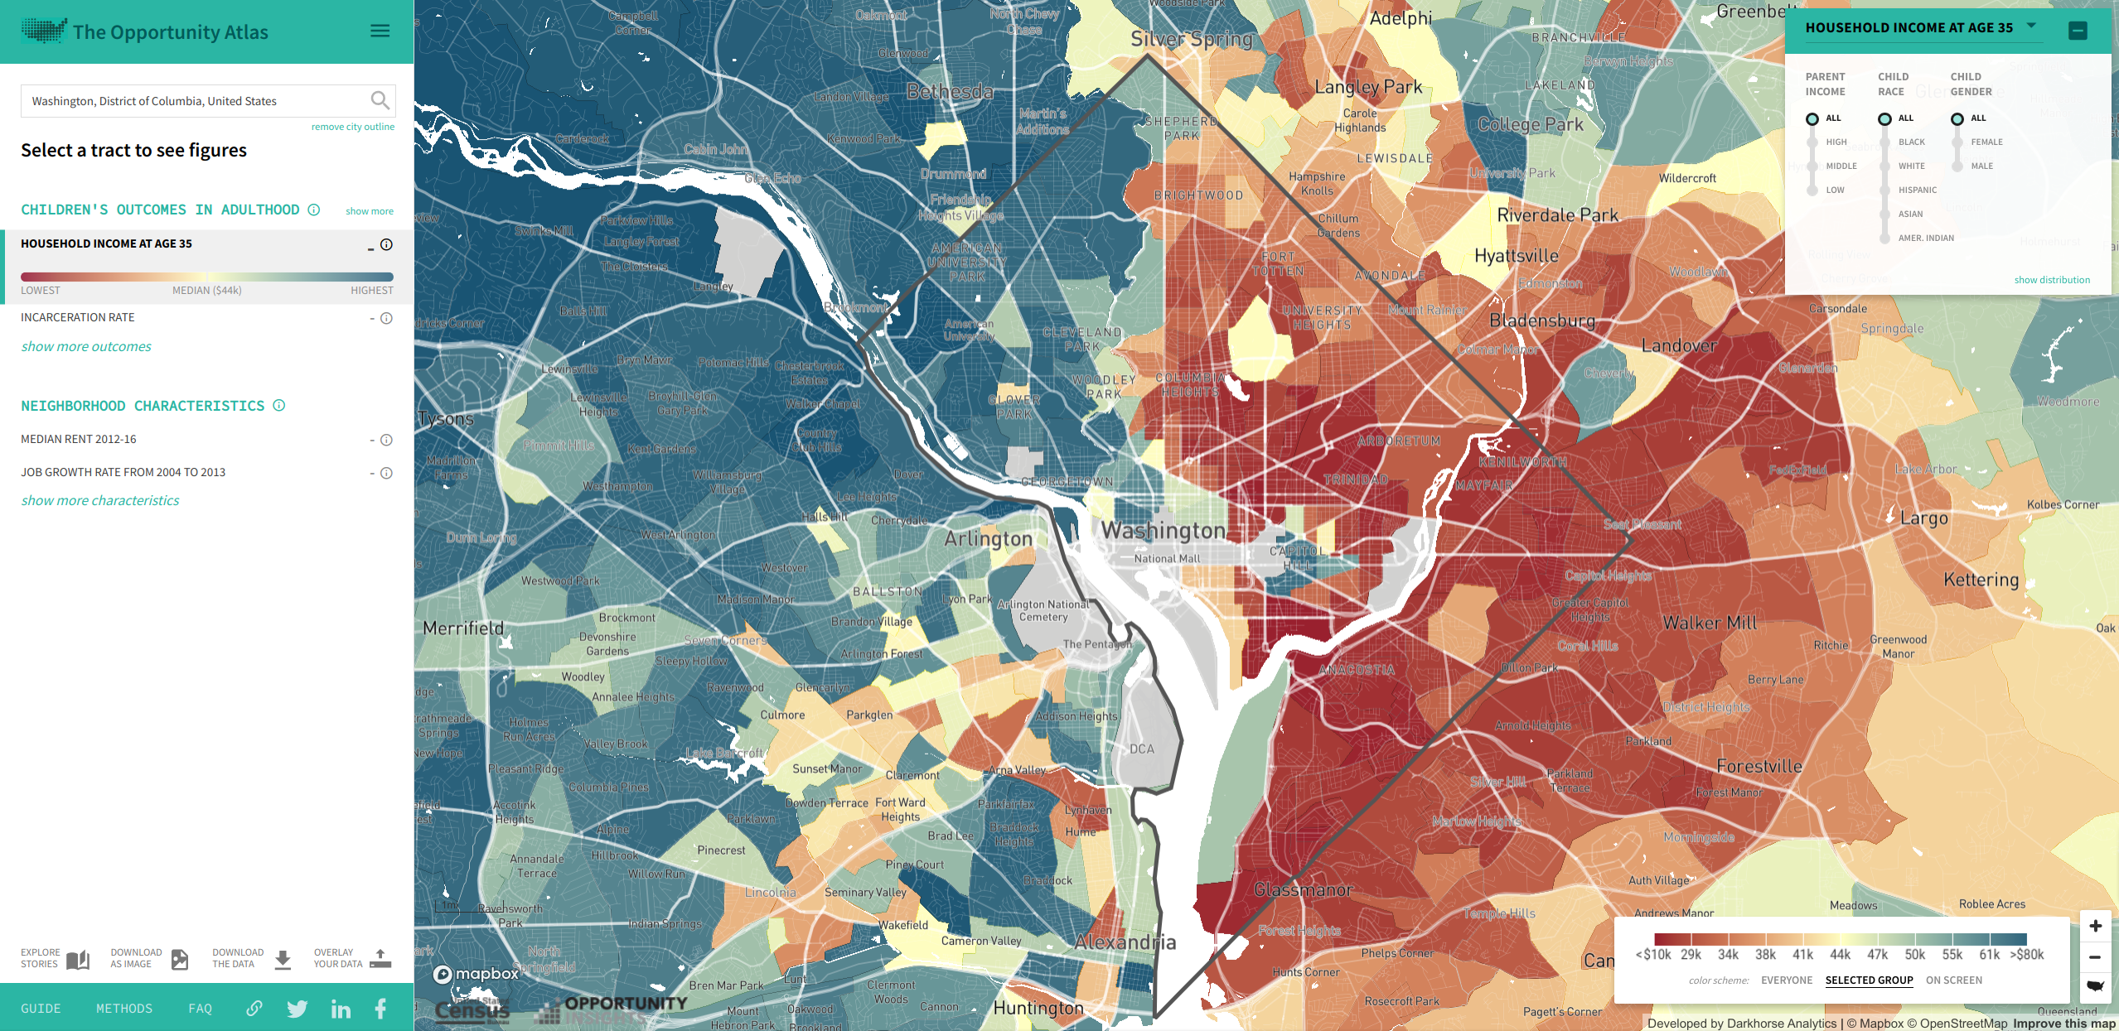
ZIP code at birth predicts life outcomes
https://www.opportunityatlas.org/

Slide 15
Questions about the origin of segregation
Top-down segregation: Discriminatory policies
Bottom-up segregation: Individual location choices influenced by:
Price of housing and services
Access to religious centers and education
Tenant exclusion and bias
What is the role of inhabitant intolerance to different neighbors?
Without central discrimination, can segregation emerge even when individuals tolerate living in a neighborhood in which they are in the minority?

Slide 16
Overview
1. Segregation
2. Schelling's segregation model
3. Analyzing Schelling's model
4. Cellular Automata: The game of life

Slide 17
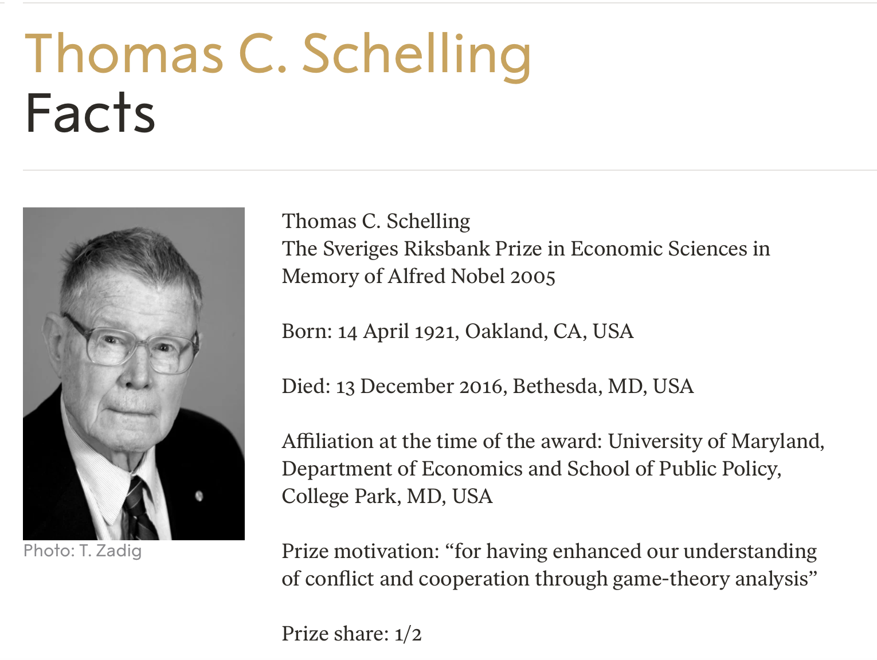

Slide 18
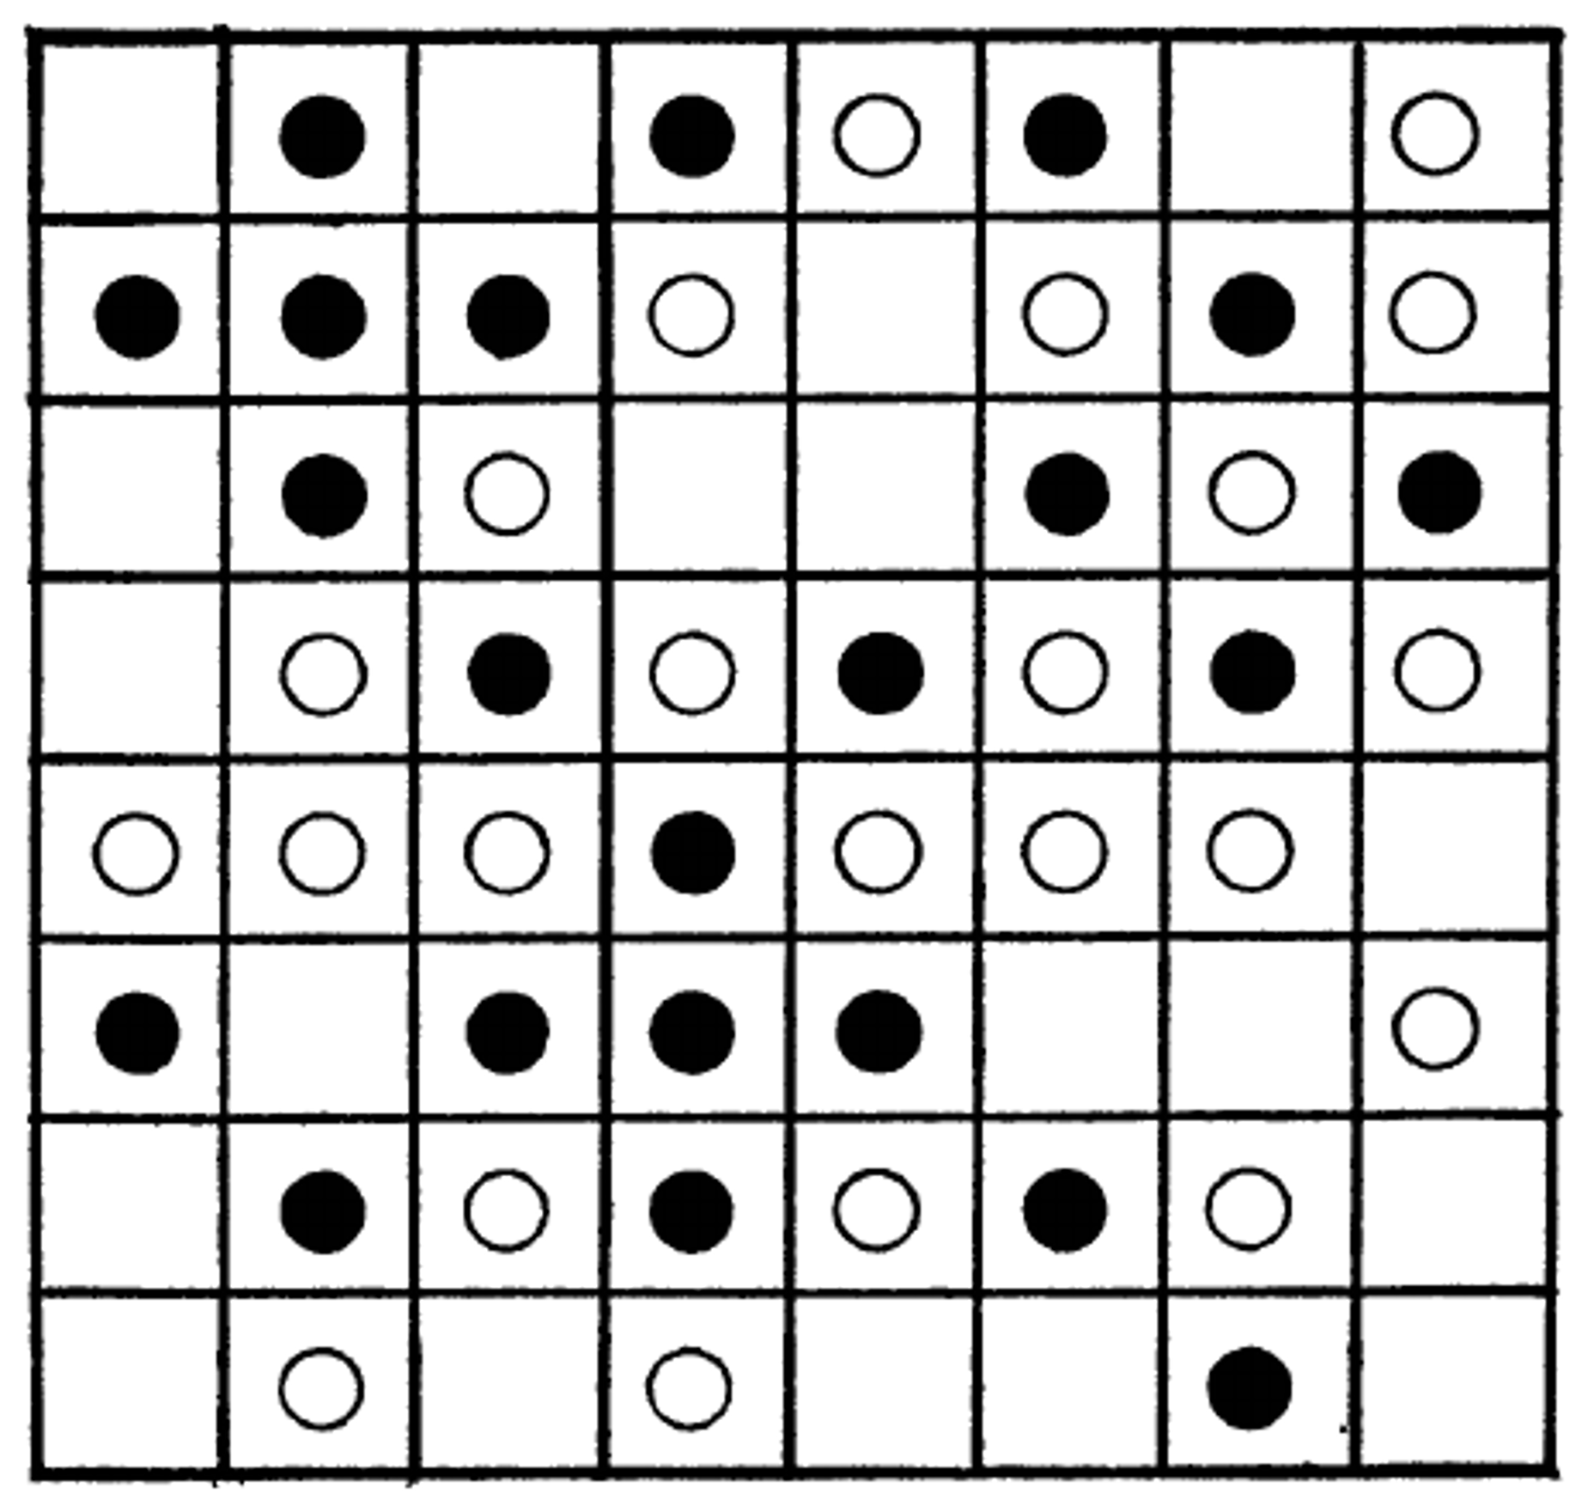
Schelling's model setup
Agents of two kinds, similar number (here 22 and 23)
Low but nonzero fraction of empty cells (here 19)
Cells have a neighborhood of 8 cells (3x3 - 1)
Border and corner cells have smaller neighborhood
Agents are aware of the fraction of similar agents in their neighborhood: f
F measures intolerance
Agents are satisfied with f ≥ F

Slide 19
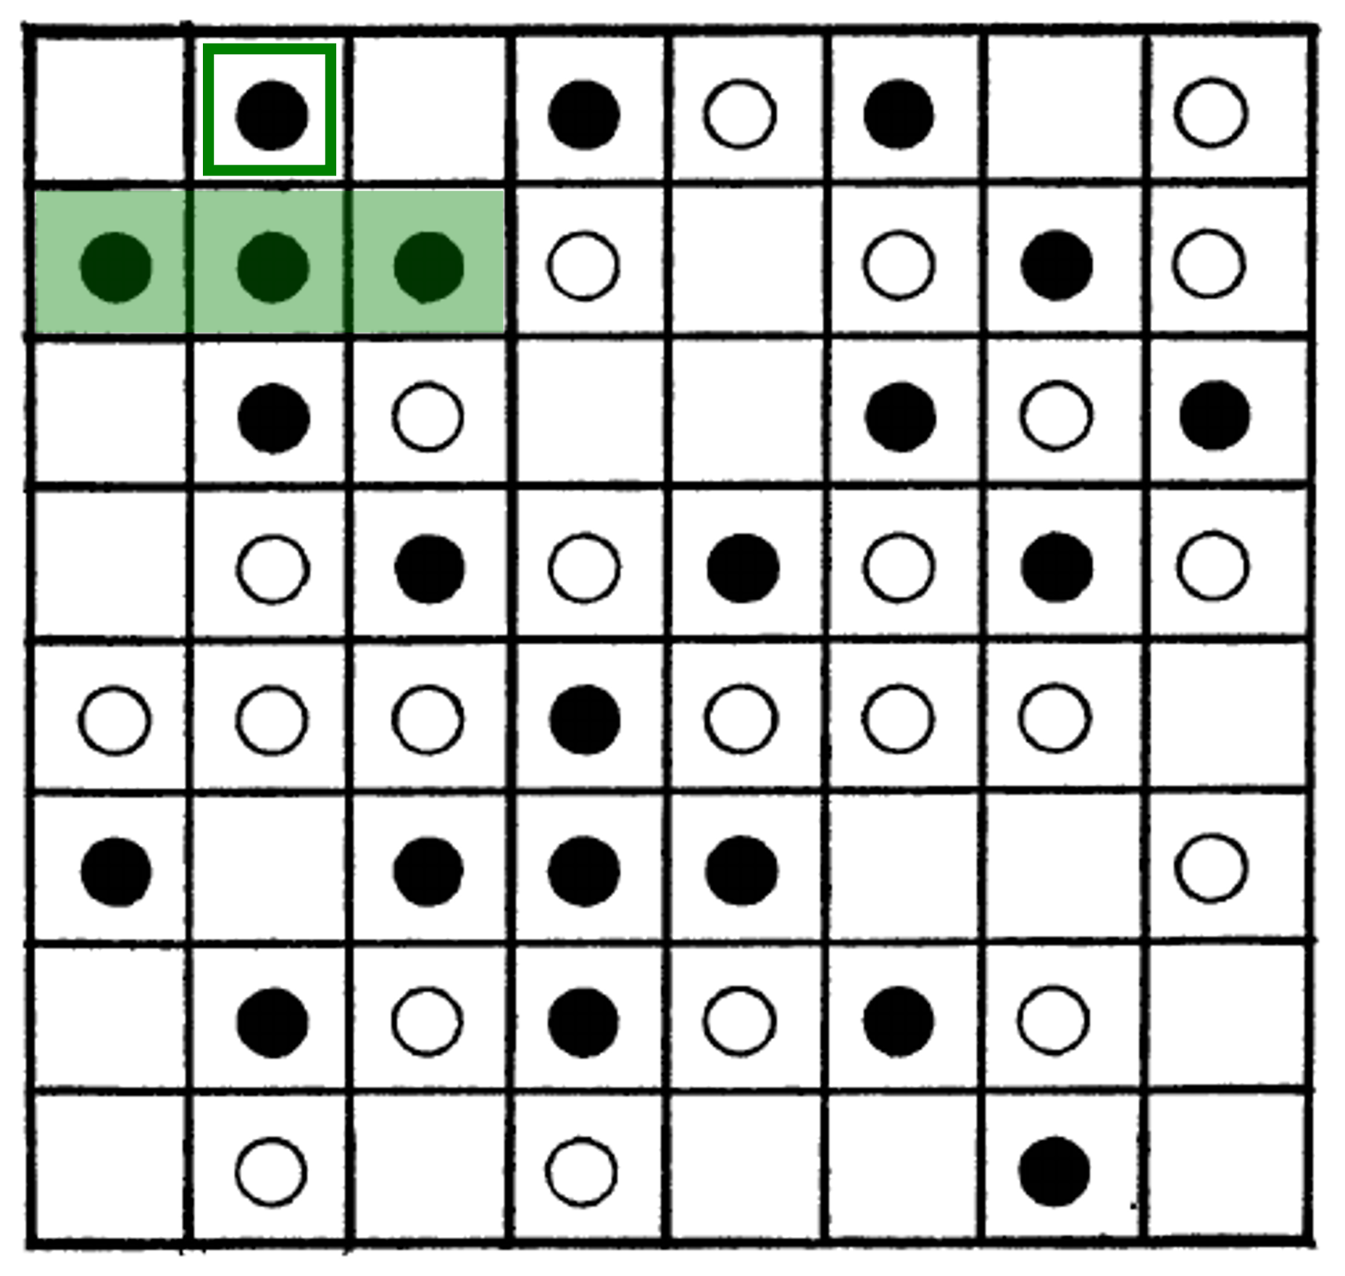
Relocation example
F=0.35
3/3 neighbors are equal:
agent stays
Remember:
Only occupied neighbor cells count
Cells close to the border have smaller neighborhoods

Slide 20
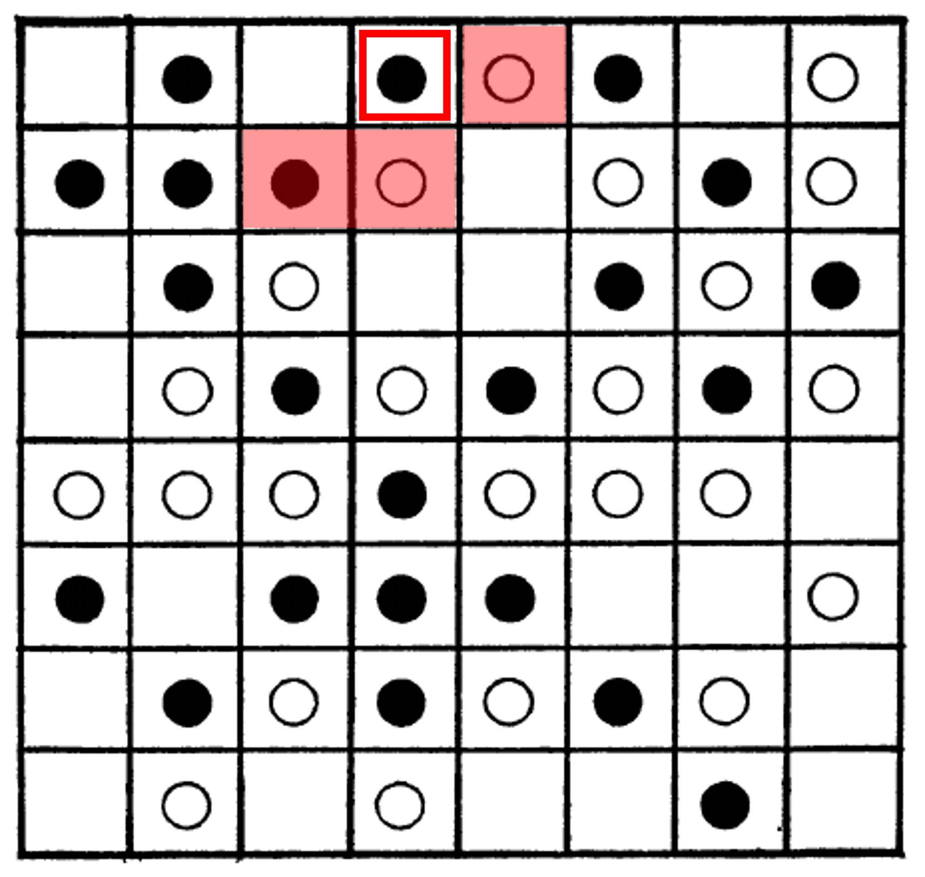
Relocation example
F=0.35
1/3 neighbors are equal:
1/3 < 0.35
agent marked for relocation

Slide 21
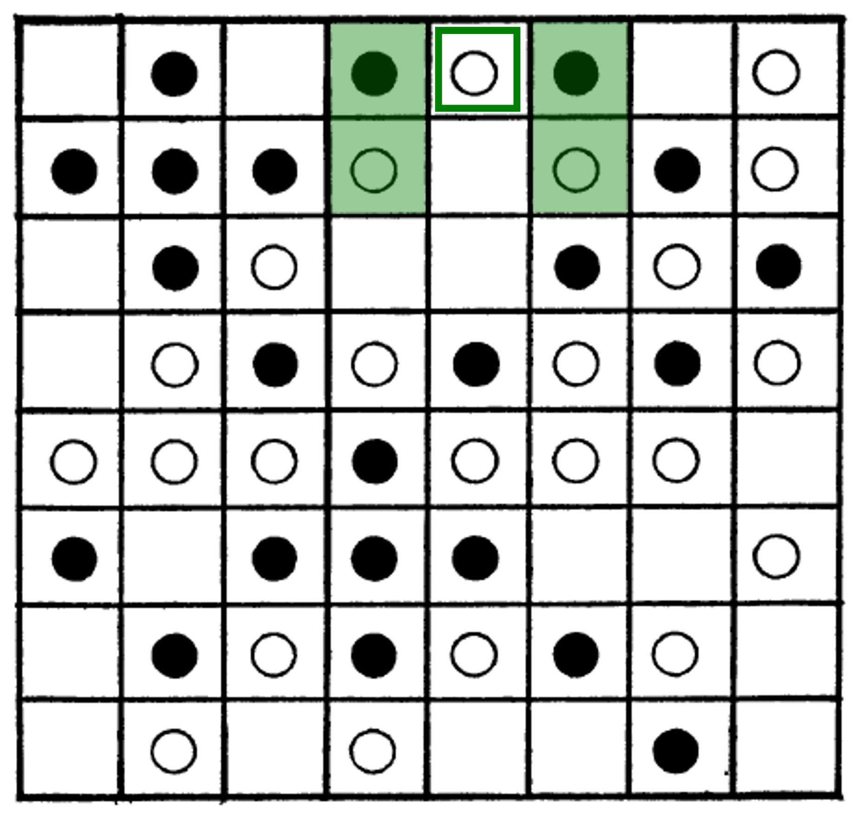
Relocation example
F=0.35
2/4 neighbors are equal:
0.5 > 0.35
Agent stays

Slide 22
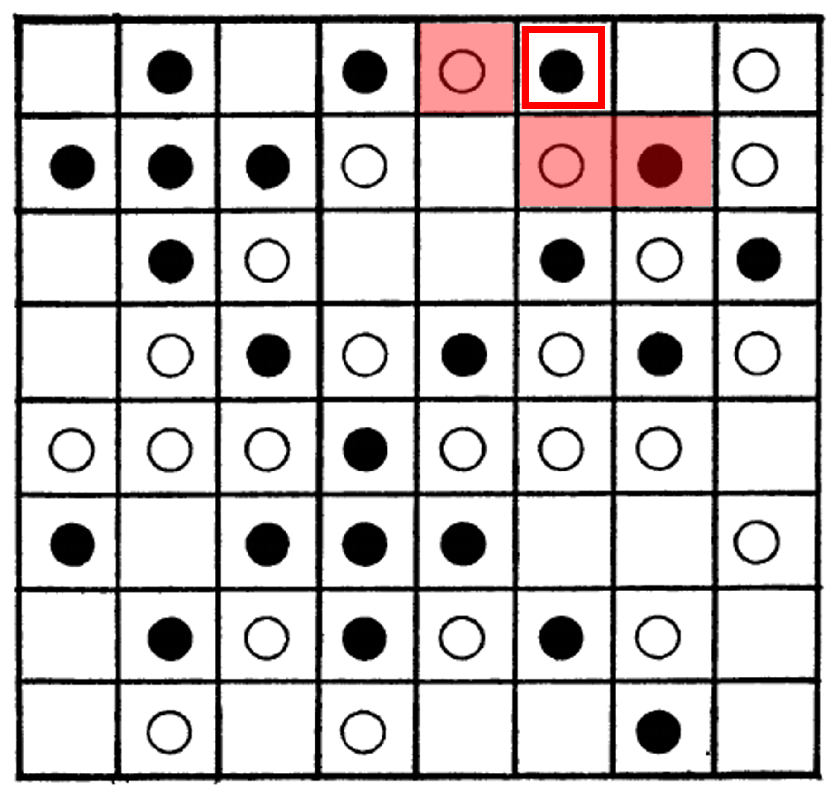
Relocation example
F=0.35
1/3 neighbors are equal:
1/3 < 0.35
agent marked for relocation

Slide 23
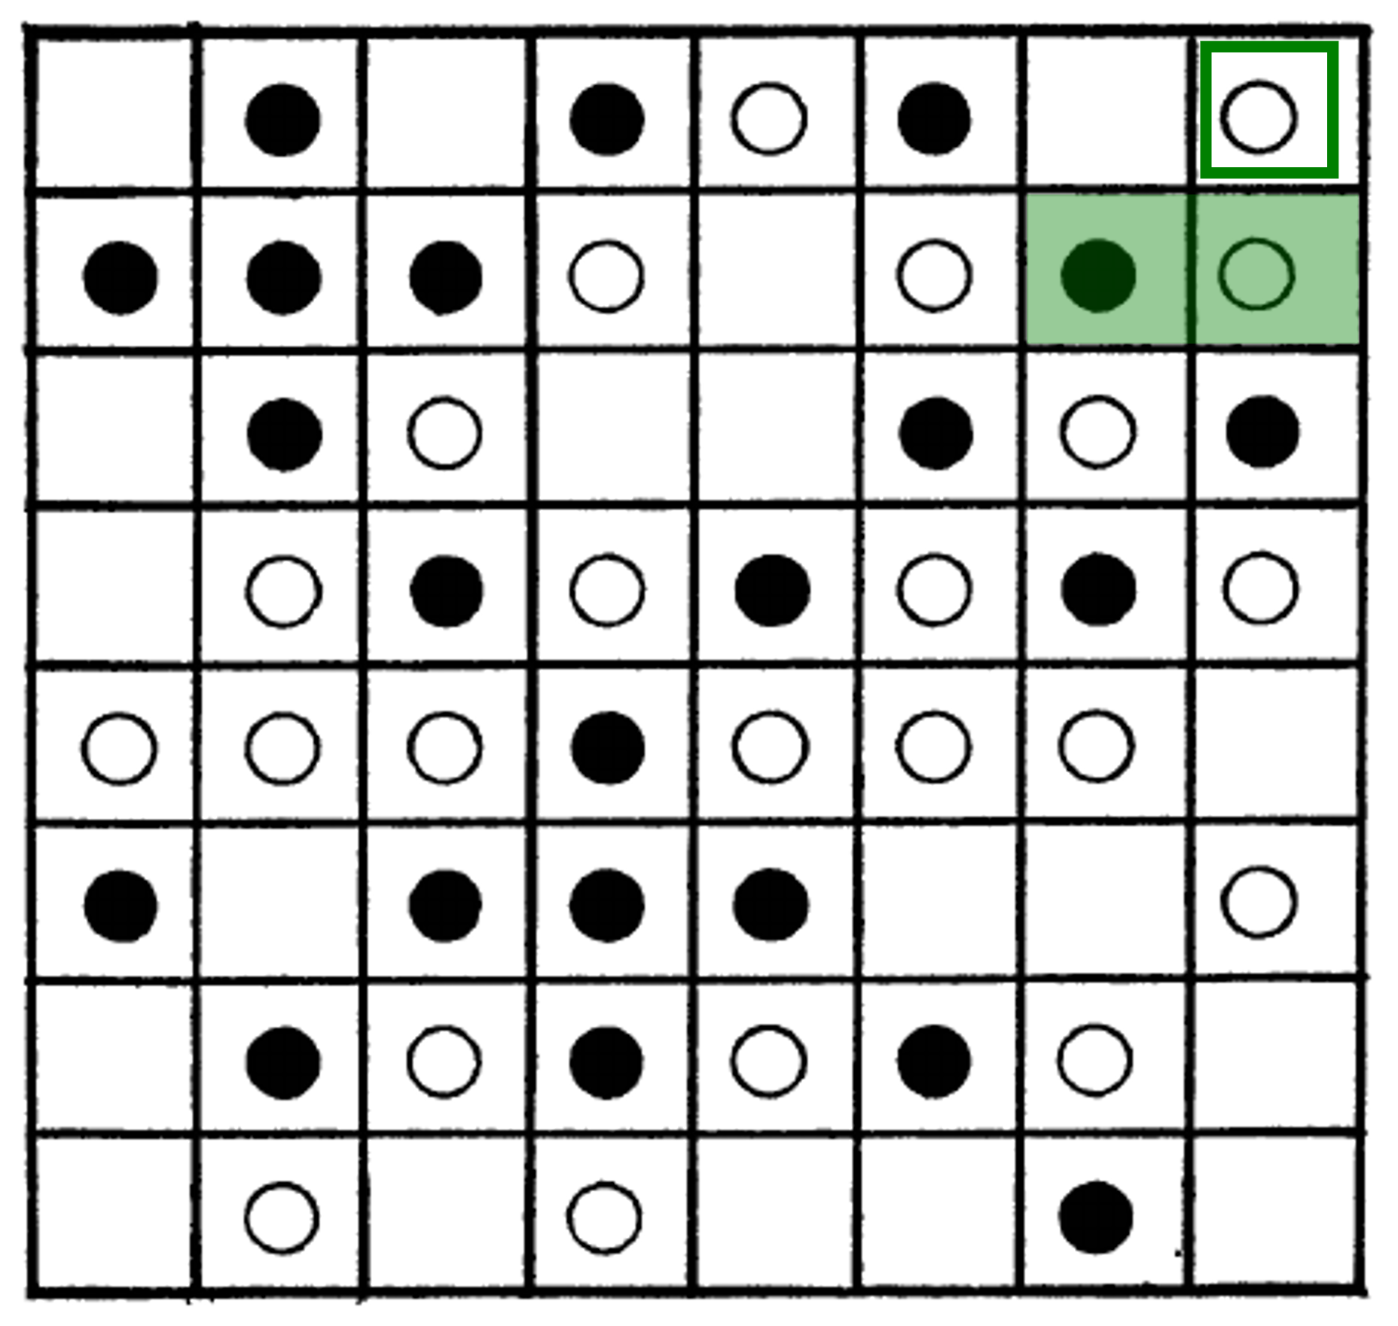
Relocation example
F=0.35
1/2 neighbors are equal:
0.5 > 0.35
agent stays
Note:
Corner cells have at most three neighbors

Slide 24
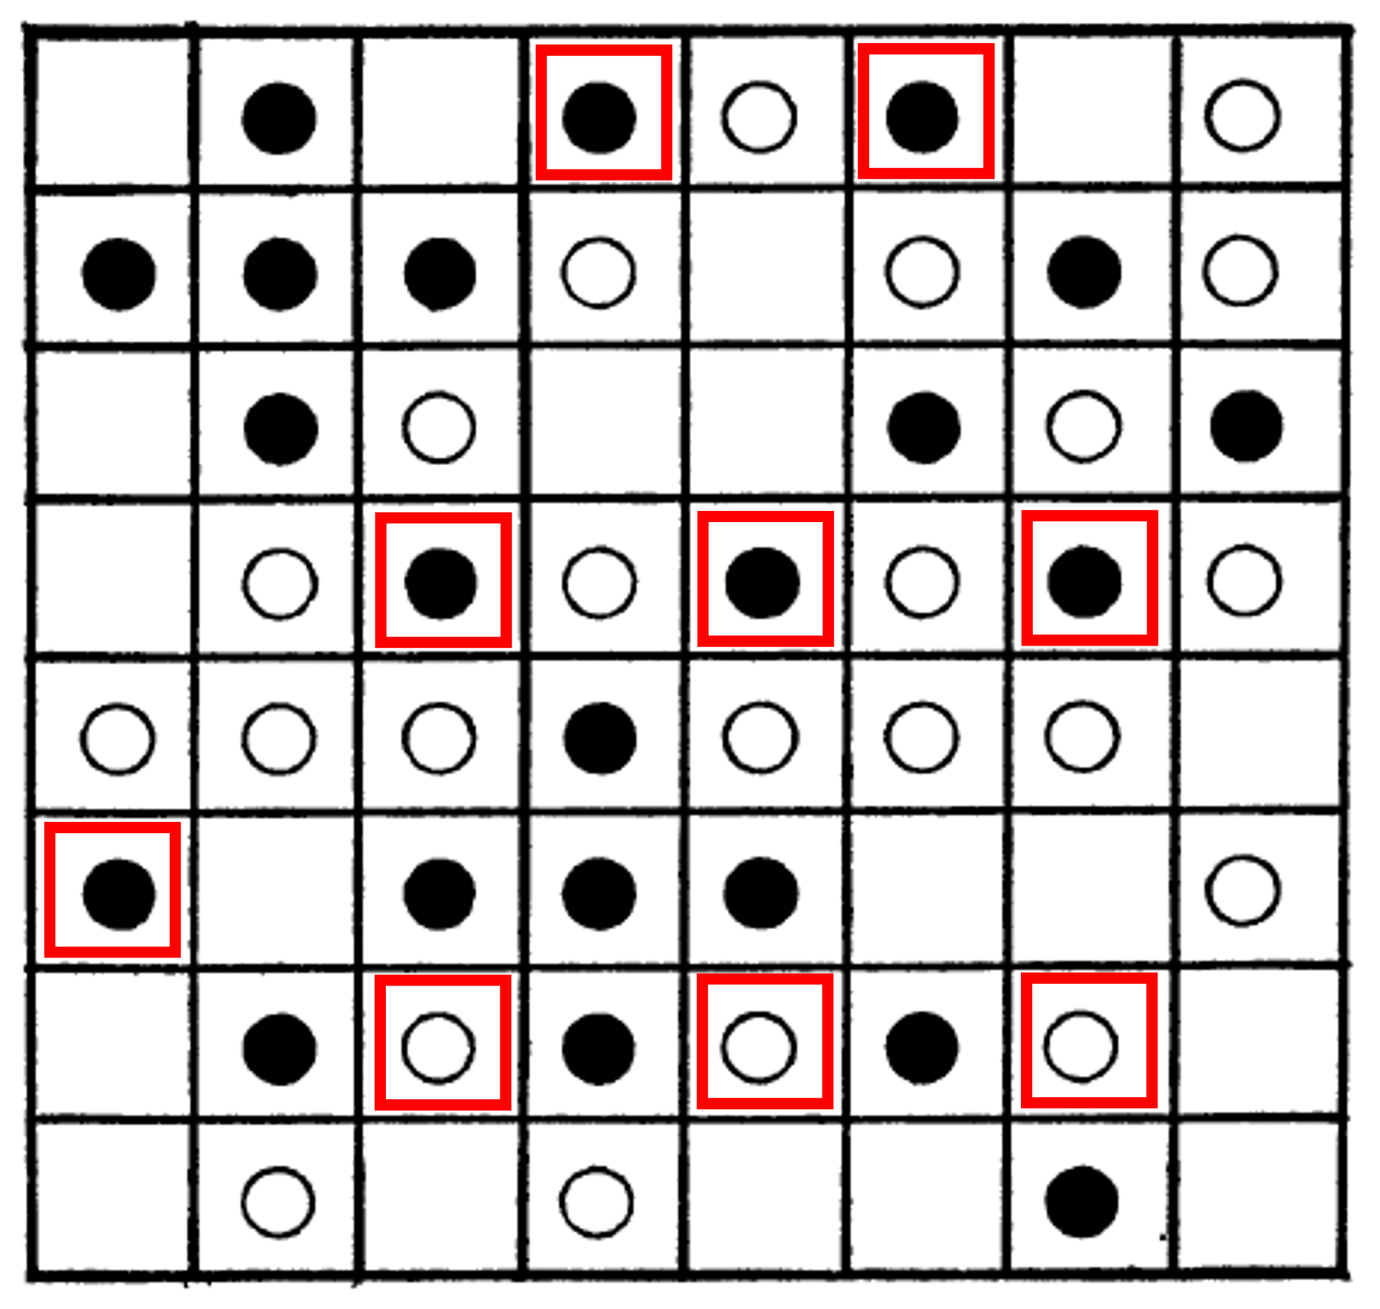
Relocation example
"Unhappy" agents with f < F
Relocation is based on a sequence and a rule where to jump
Some variability in this step:
Random sequence or ordered
Options about jumps: a) closest happy free spot b) happiest free spot: max(f), even if new f still below F
c) random free spot
Notes:
These variations you can examine in the tutorial session or at home

Slide 25
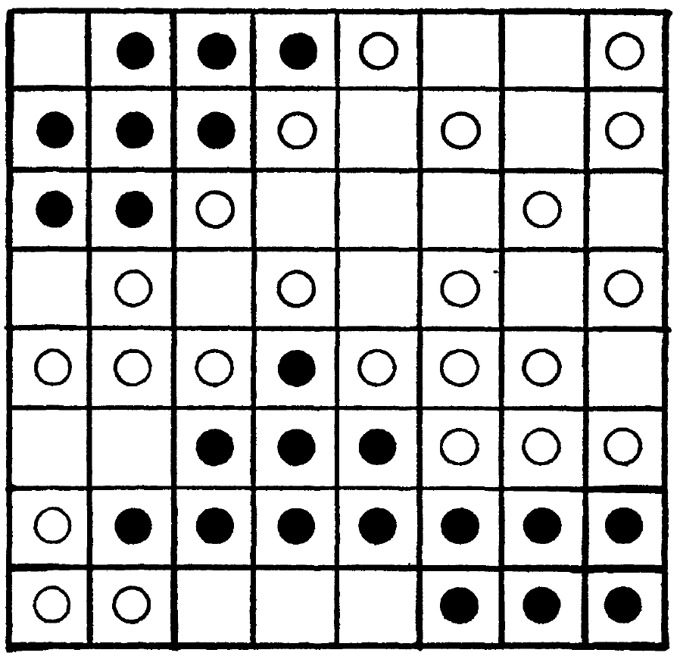
Simulation results
Even when F=0.35 is not that high!
State after running a few iterations
All agents are satisfied ( f≥F )
No more relocations take place (simulation ends)
Result looks segregated
Two large black regions
Rest formed by scattered white agents

Slide 26
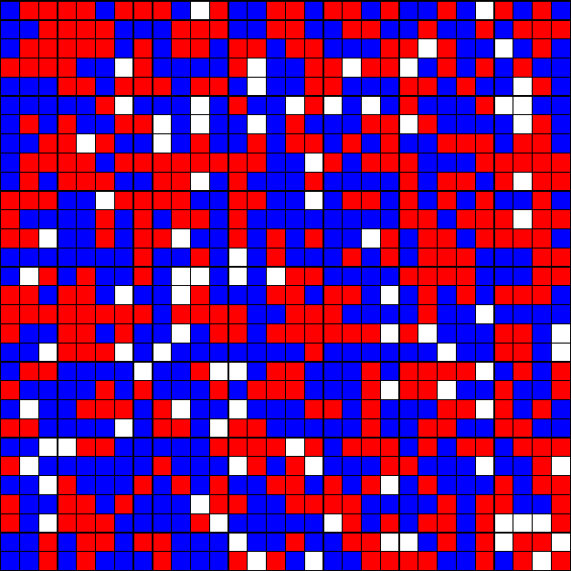
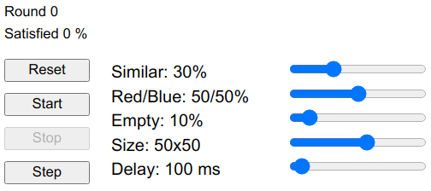
Simulation configuration
http://nifty.stanford.edu/2014/mccown-schelling-model-segregation/
Random initial configuration
Parameters can be changed
Reporting % satisfied agents and simulation round
Notes:
Let’s explore together ; go to the website.
http://nifty.stanford.edu/2014/mccown-schelling-model-segregation/

Slide 27
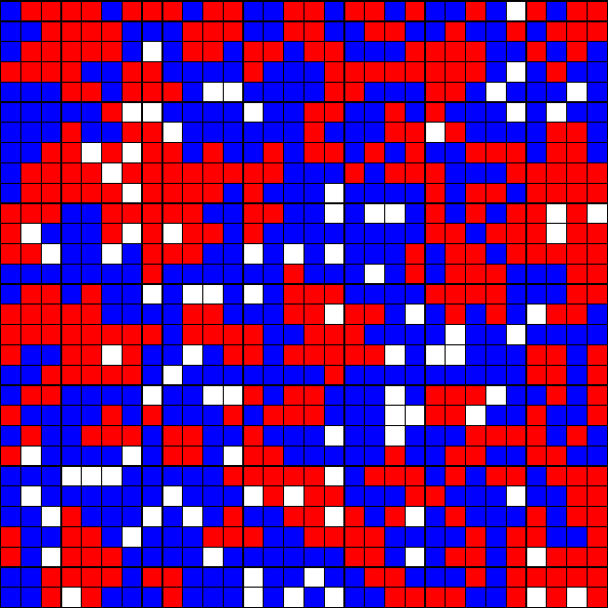
High tolerance case (low F)
F=0.2
Result very similar to initial configuration
No apparent segregation
All agents satisfied soon

Slide 28
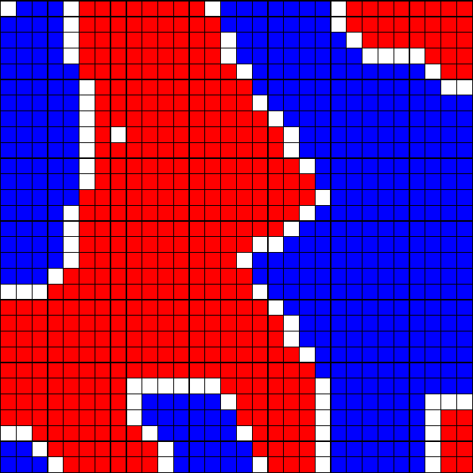
High intolerance case
F=0.6
Result is very segregated
Empty cells form borders between clusters
Several iterations are necessary for all agents to be satisfied

Slide 29
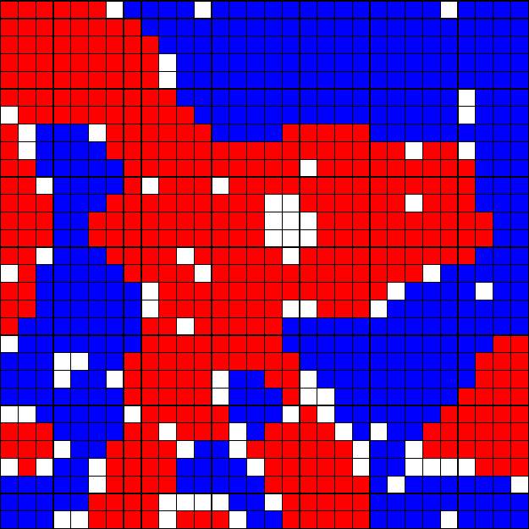
0.5 intolerance case
F=0.5
Result is substantially segregated
Empty cells form borders between clusters
Several iterations are necessary for all agents to be satisfied

Slide 30
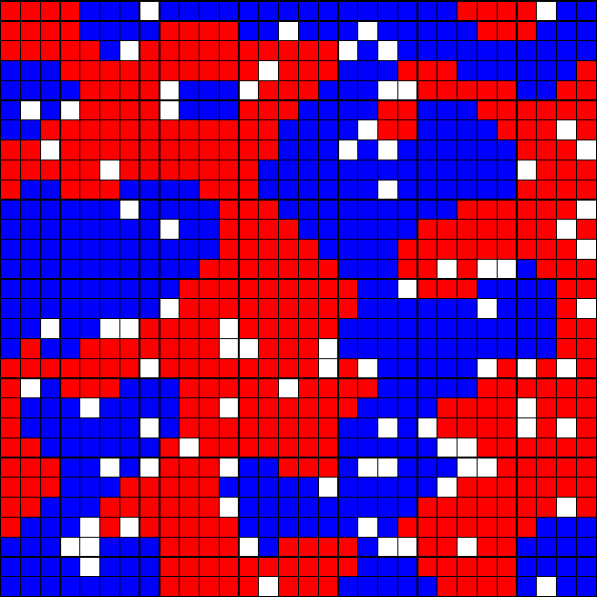
0.4 intolerance case
F=0.4
Result is also segregated
Agents are OK living in minority!
All agents can be satisfied

Slide 31
Overview
1. Segregation
2. Schelling's segregation model
3. Analyzing Schelling's model
4. Cellular Automata: The game of life

Slide 32
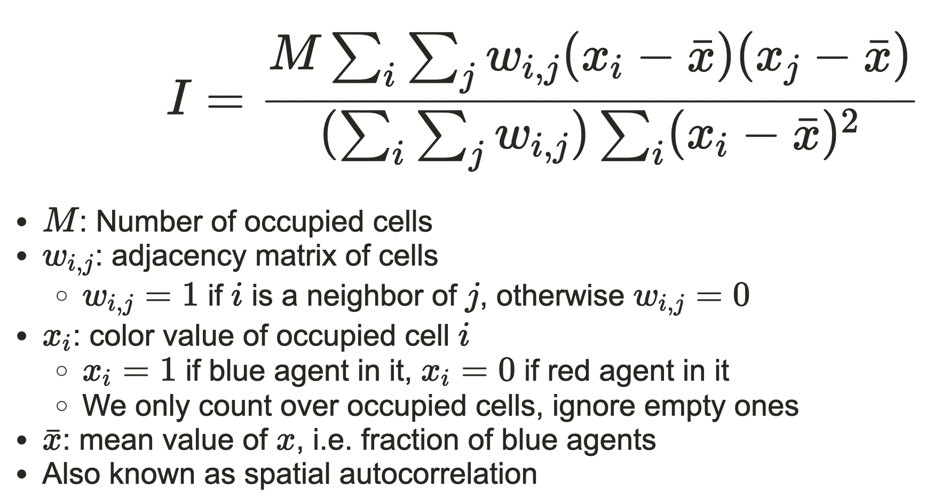
Measuring segregation: Moran's I
Moran, P. A. P. (1950).
M: Number of occupied cells
wi,j: adjacency matrix of cells
wi,j=1 if i is a neighbor of j, otherwise wi,j=0
xi: color value of occupied cell i
xi=1 if blue agent in it, xi=0 if red agent in it
We only count over occupied cells, ignore empty ones
¯x: mean value of x, i.e. fraction of blue agents
Also known as spatial autocorrelation

Slide 33
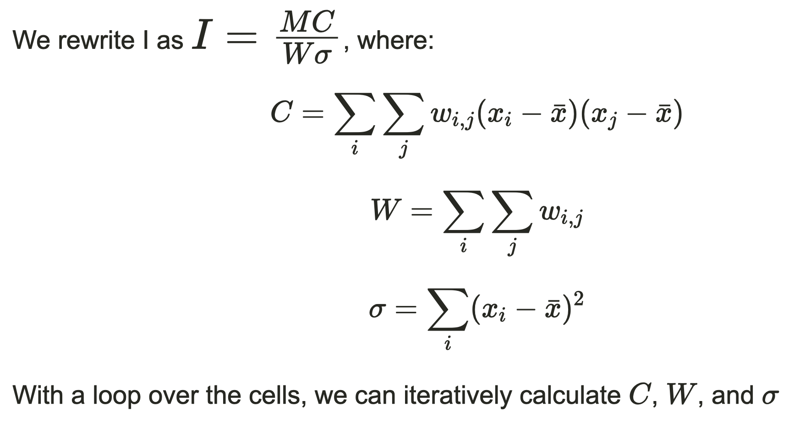
How to calculate Moran's I
Notes:
Write in the blackboard

Slide 34
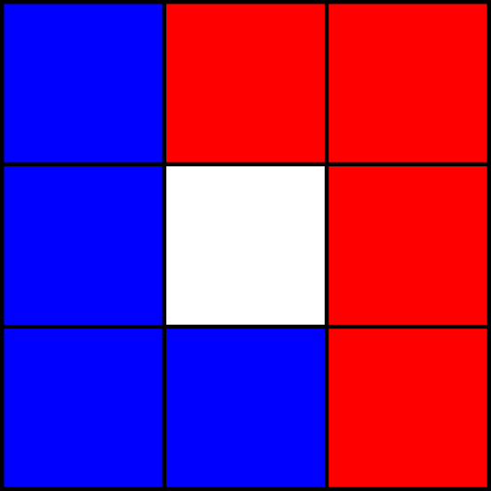
Moran's I example
Example: 9 cells
3x3 neighborhood
4 red and 4 blue agents
xi=0 if i occupied by blue
xi=1 if i occupied by red
Avg(x)=0.5
M=8

Slide 35
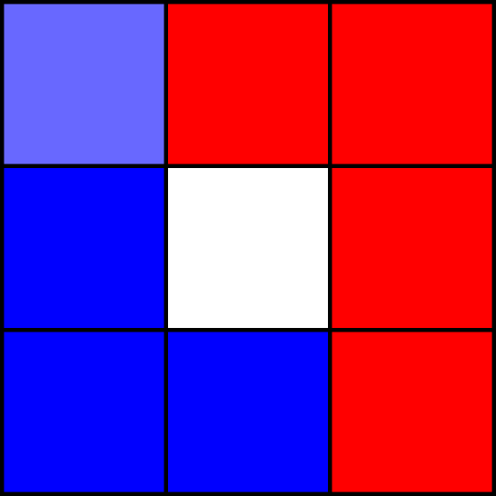
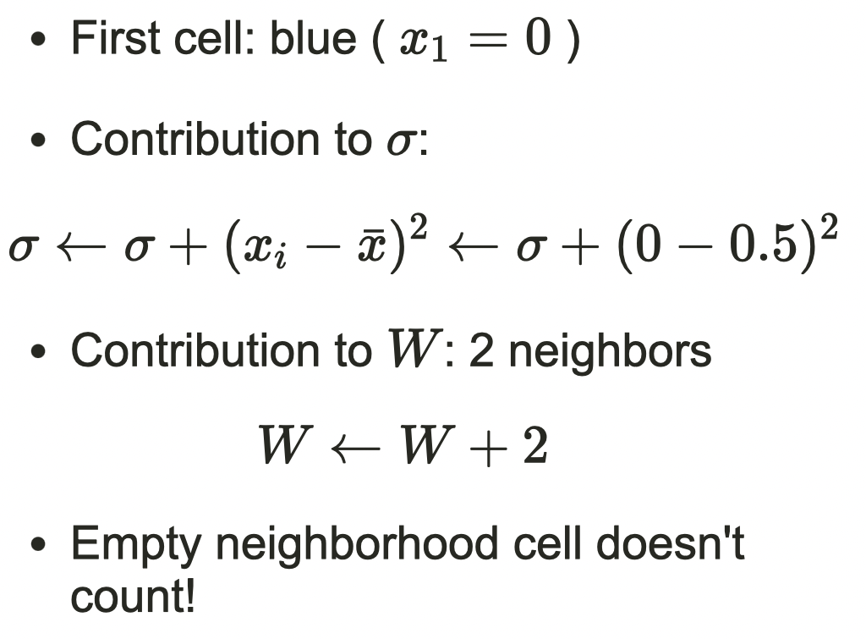
Moran's I example

Slide 36
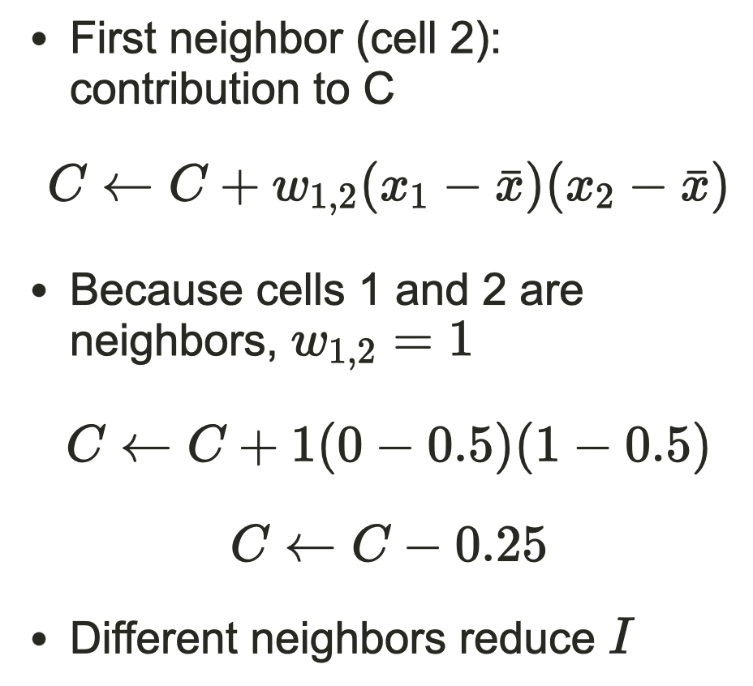
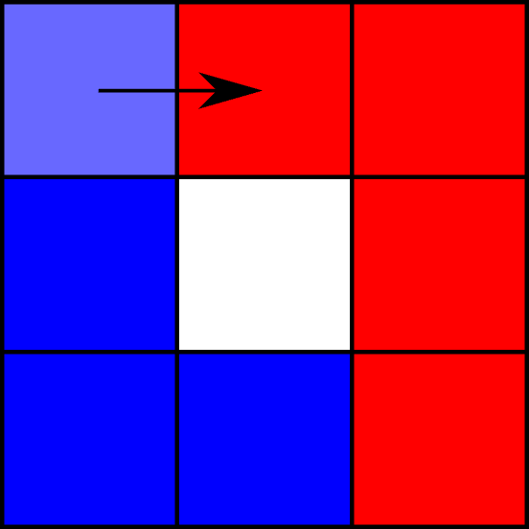
Moran's I example

Slide 37
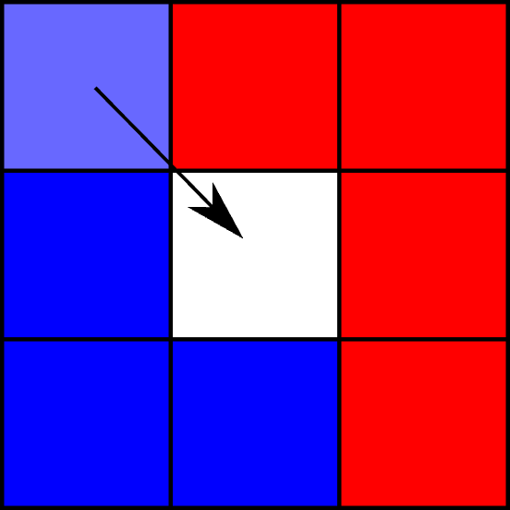
Moran's I example
Second neighbor (cell 5)
Does not contribute to C because
it is empty

Slide 38
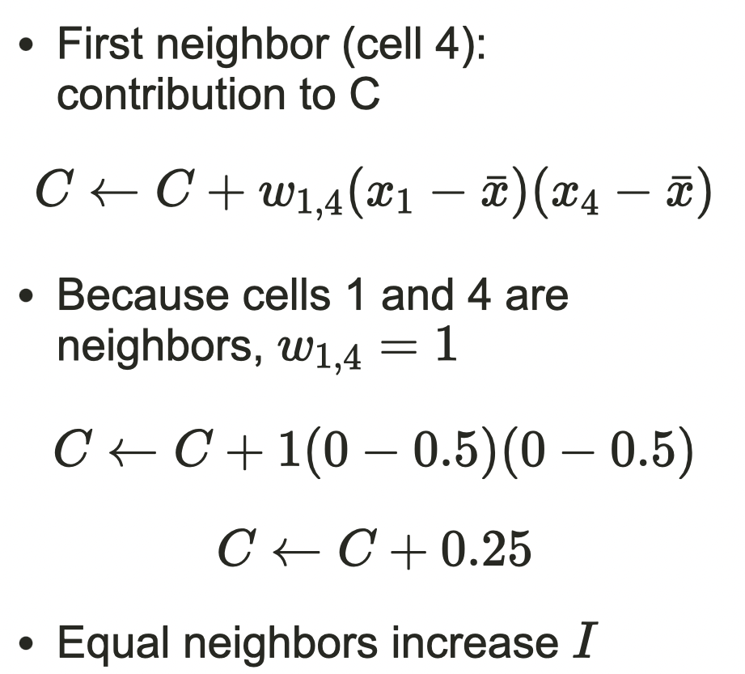
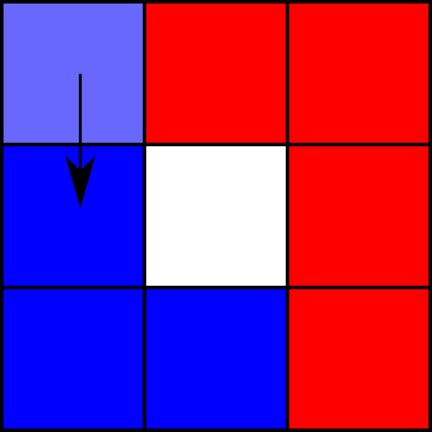
Moran's I example

Slide 39
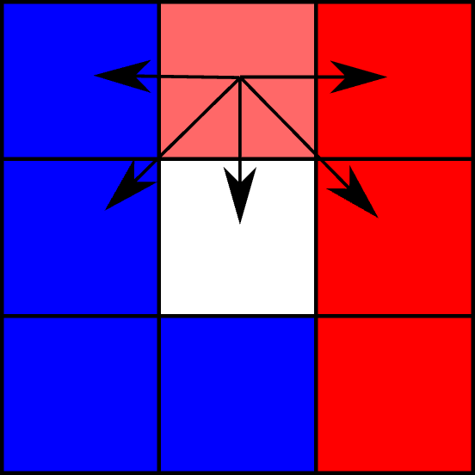
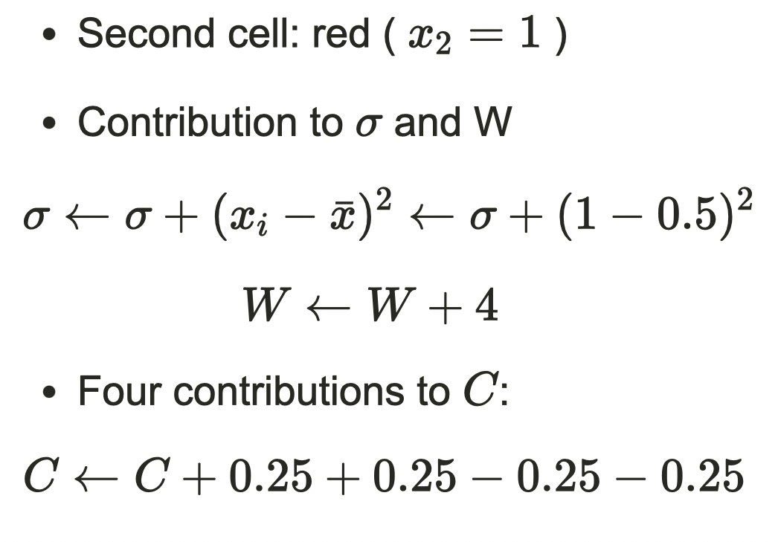
Moran's I example

Slide 40
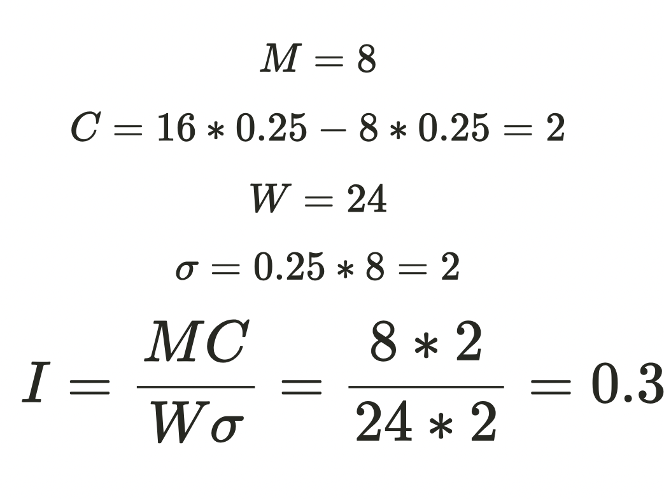
Moran's I example
Notes:
Following this iterative process, you will get
Basically we made a for loop ; for each cell, calculate sigma, W, and for all the neighbors of the cell, measure C and sum them

Slide 41
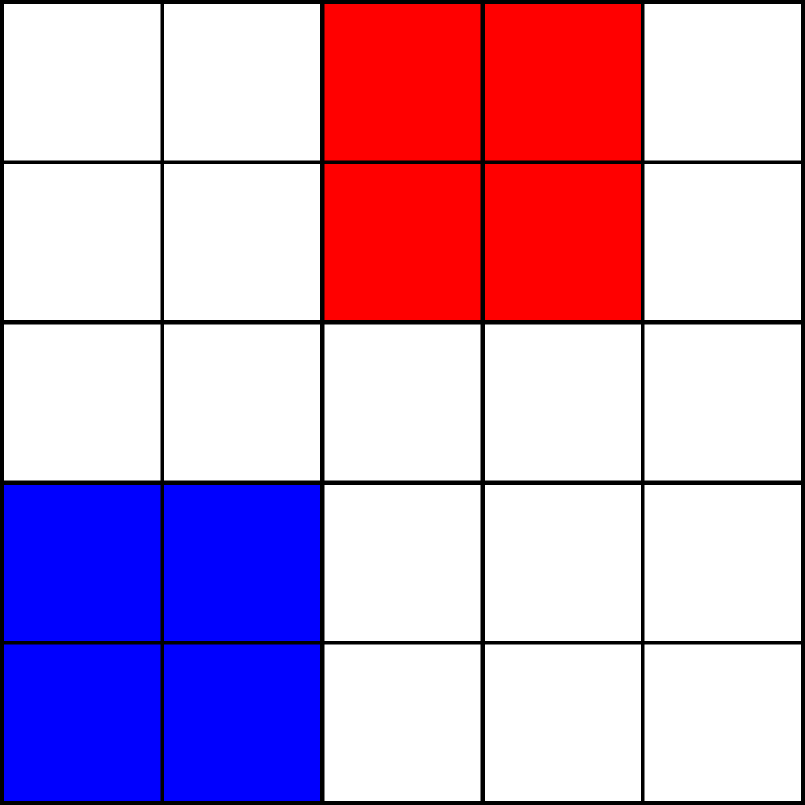
Maximum Moran's I example
Calculate the Moran Index for this
Hint: team up in a group of 2 and split the task:
C , W , sigma

Slide 42
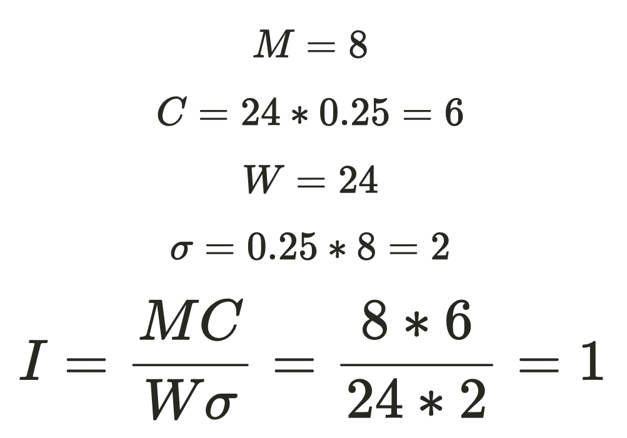
Maximum Moran's I example

Slide 43
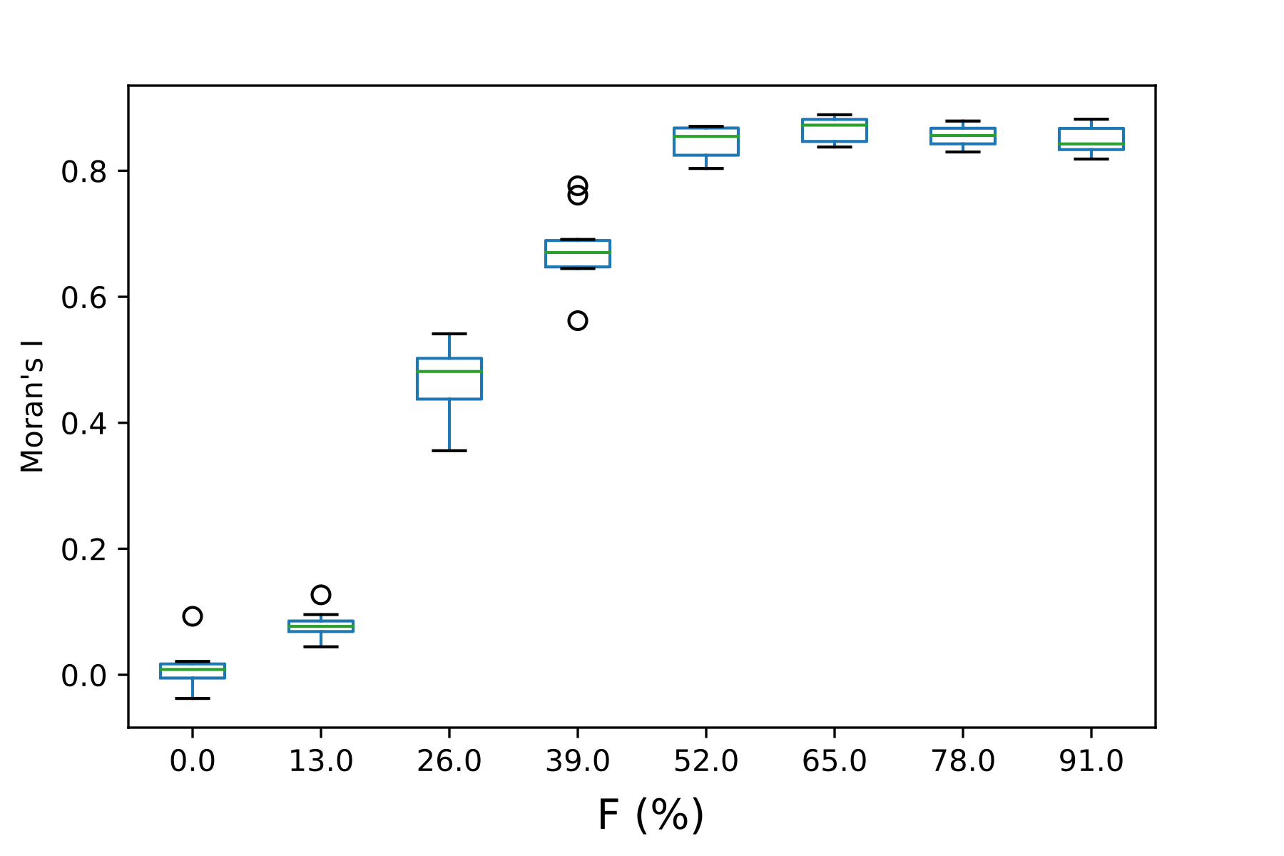
Segregation versus tolerance
3x3 neighborhood (up to 8 neighbors), torus edges
Boxplots of Moran I after convergence in several simulations
Moran's I stays low for low F values
Sharp increase above two neighbors for F
Substantial segregation for F>0.33

Slide 44
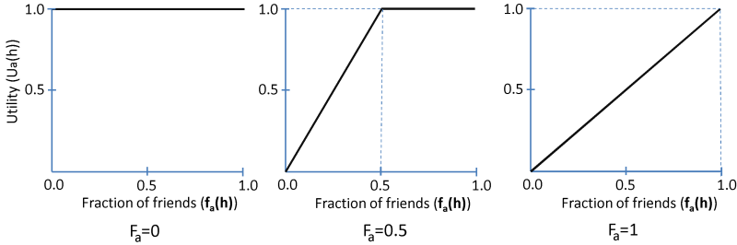
Generalizing relocation rules
Modeling the utility of an agent under with certain fraction of similar agents
Probability to relocate every iteration: 1 - utility
Happiness is measured as total utility
Notes:
As Utility increases, the probability of relocation decreases

Slide 45
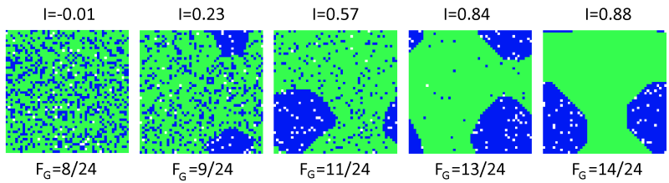
Coexistence between segregation and mixtures
Generalization of model: different number of agents per color and different thresholds for each color
Model reproduces observed clusters of one group with mixed regions
The Schelling Model of Ethnic Residential Dynamics: Beyond the Integrated - Segregated Dichotomy of Patterns. Erez Hatna and Itzhak Benenson. Journal of Artificial Societies and Social Simulation, 2012

Slide 46
Overview
1. Segregation
2. Schelling's segregation model
3. Analyzing Schelling's model
4. Cellular Automata: The game of life

Slide 47
Cellular Automata
agents ≡ cells, arranged on a predefined lattice
formal structure of Cellular Automata
finite or infinite grid of identical cells i=1,...,L
cell with internal state θi(t)∈{θ1,…,θn}
neighborhood configuration: βi(t)∈{β1,…,βm}
discrete dynamics for the state variable at t+1 :
θi(t+1)=F[θ(t),β(t)]
characteristics:
discrete space, time, and states
same transition rule applies to all cells
each cell is an agent (!)
Notes:
A cellular automaton (CA) is a collection of cells arranged in a grid of specified shape, such that each cell changes state as a function of time, according to a defined set of rules driven by the states of neighboring cells.

Slide 48
Cellspace and Neighbourhoods
Many types of neighbourhoods possible.
Examples in 2D:

Slide 49
Conway's Game of Life
History
John Conway (1970): design a self-replicating system
2010: first self-replicating structure in Life, called Gemini
2013: first replicator that creates a bigger copy of itself (self-similarity)
Rules of the Game
2D rectangular infinite grid with "dead" and "alive" cells
a dead cell becomes alive if 3 neighbours are alive - reproduction
an alive cell dies if less than 2 neighbours are alive - underpopulation
an alive cell dies if more than 3 neighbours are alive - overcrowding
Importance of Conway's Game of Life
complex behaviour emerges from simple rules for agents
early modeling of self-organization
To play the game: https://playgameoflife.com
Notes:
https://playgameoflife.com

Slide 50
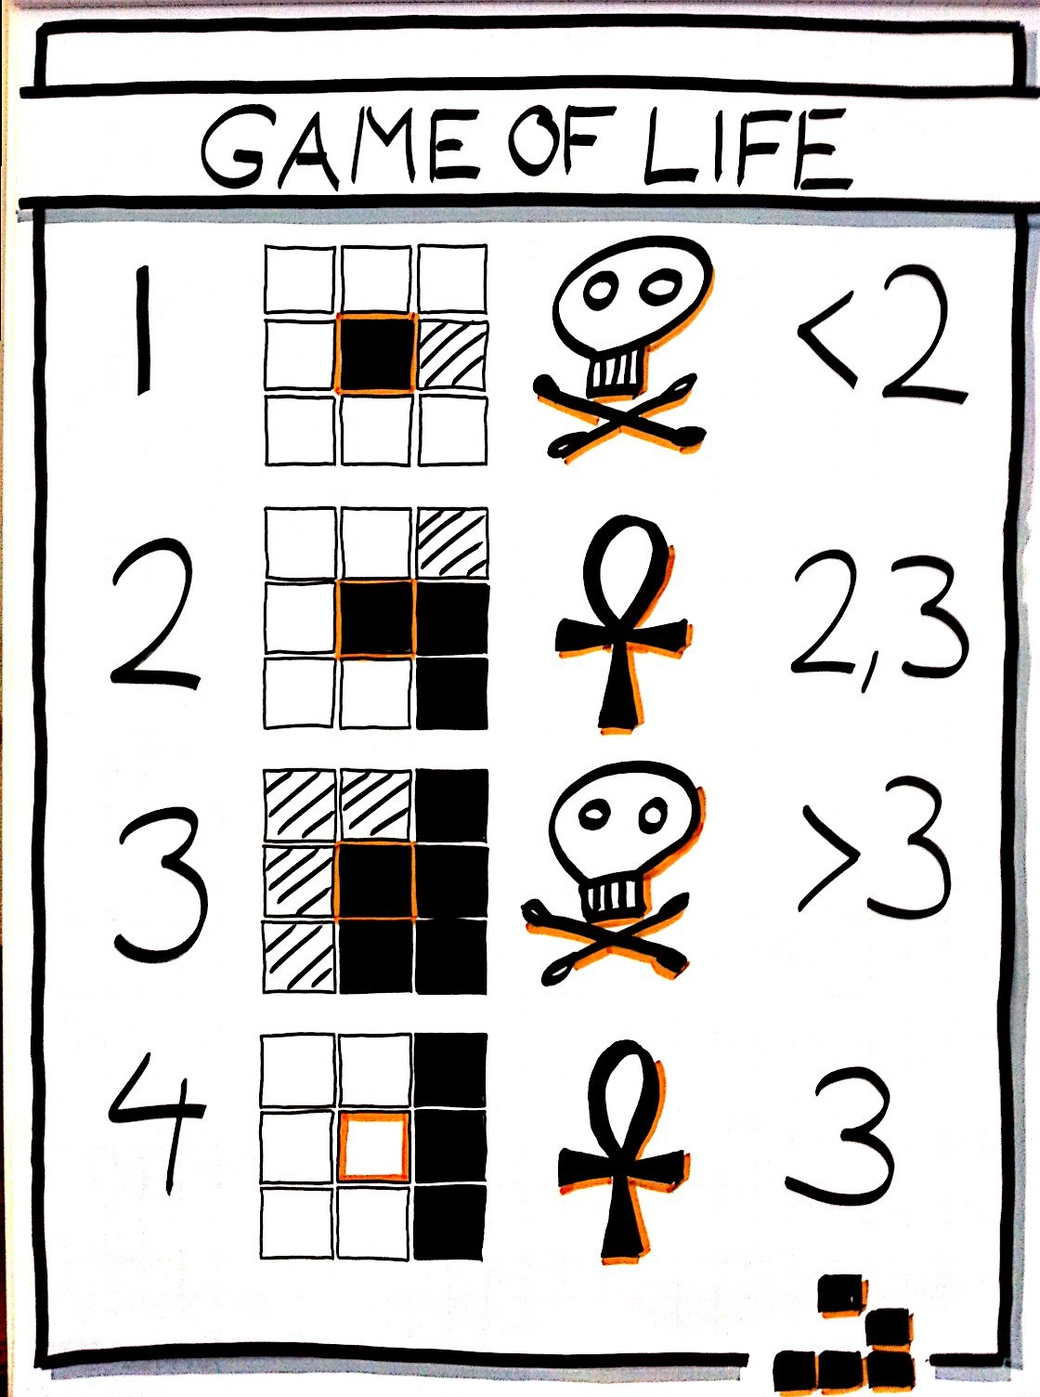
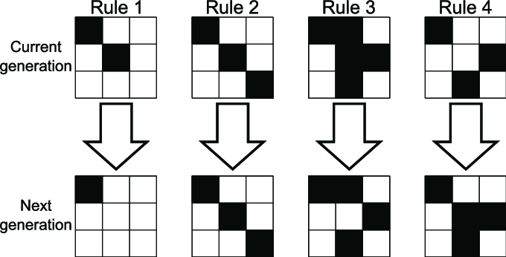
Rules of the Game of Life
Notes:
https://playgameoflife.com

Slide 51
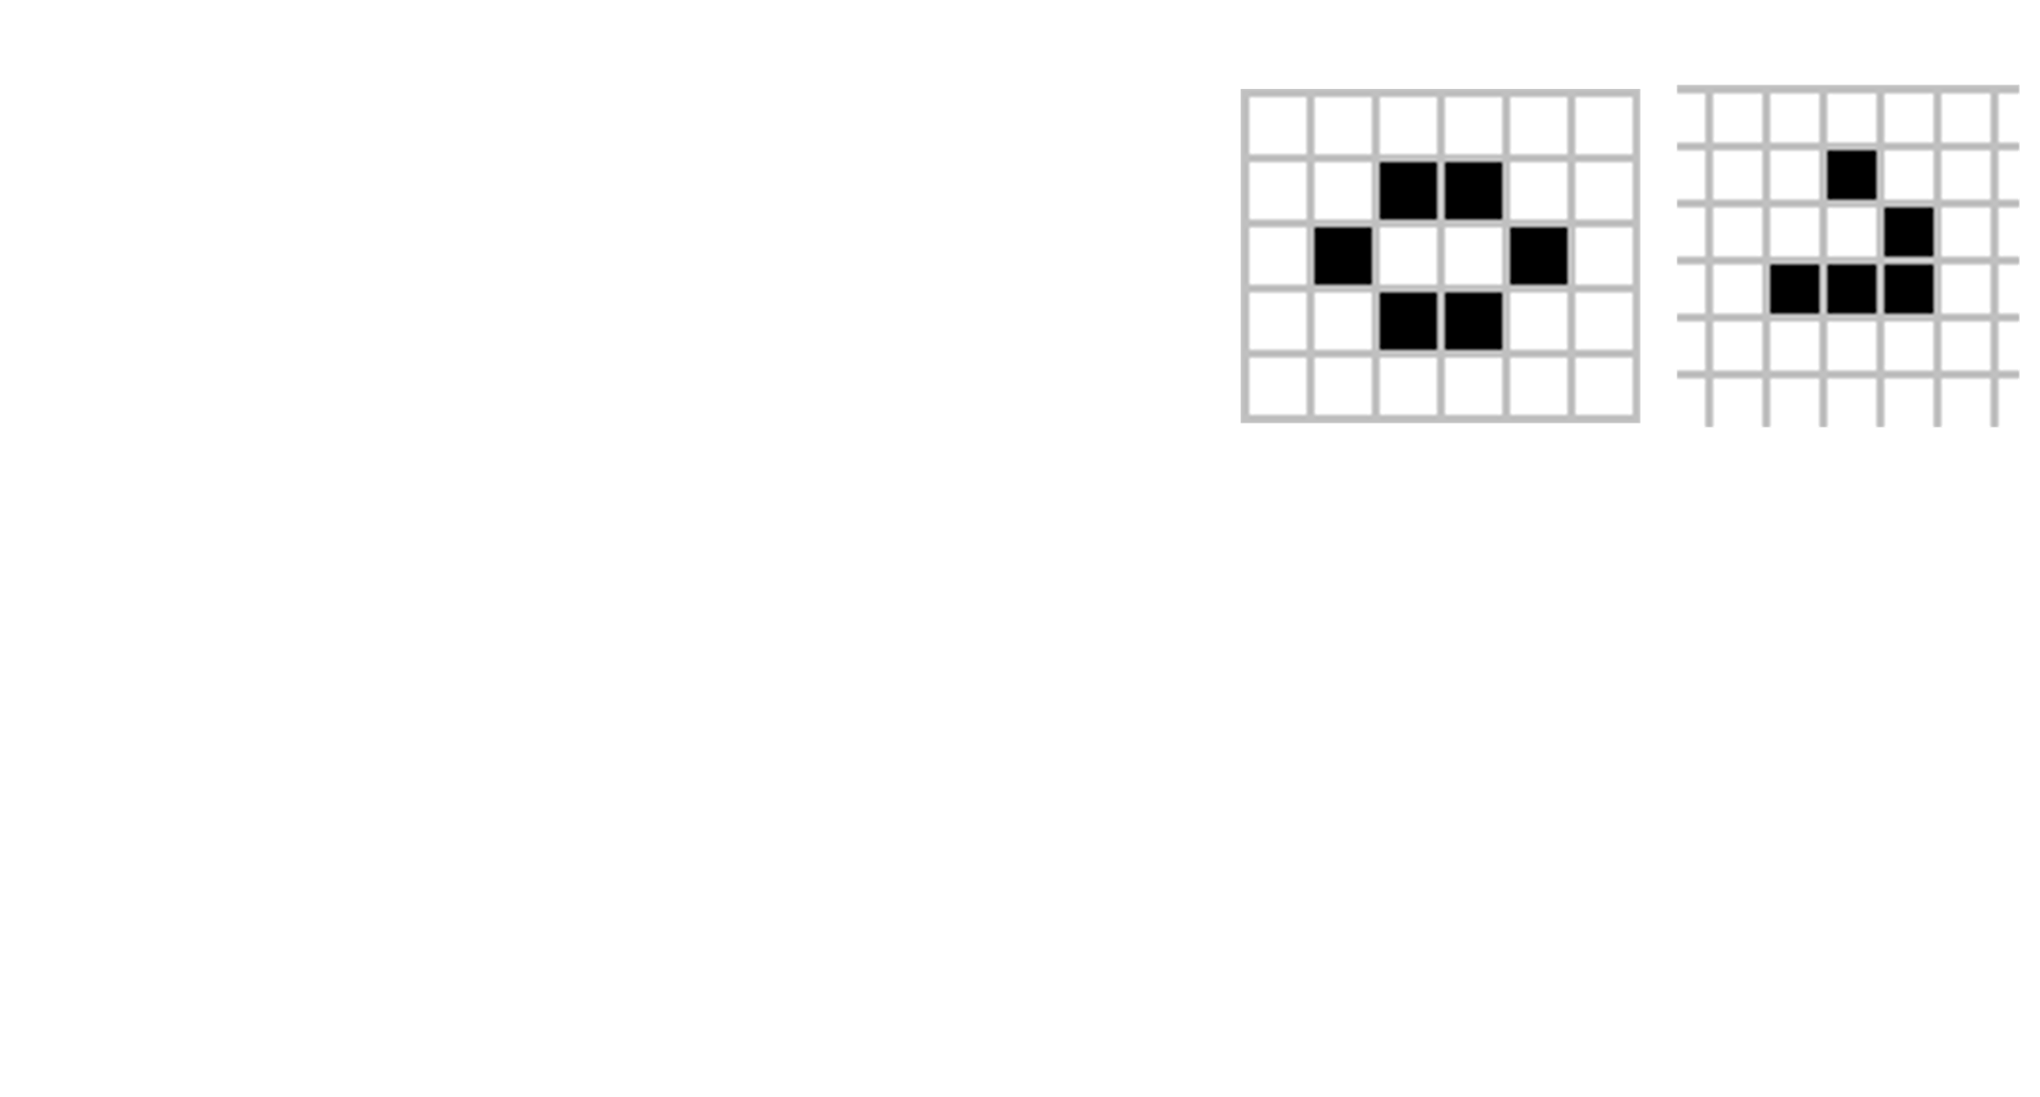
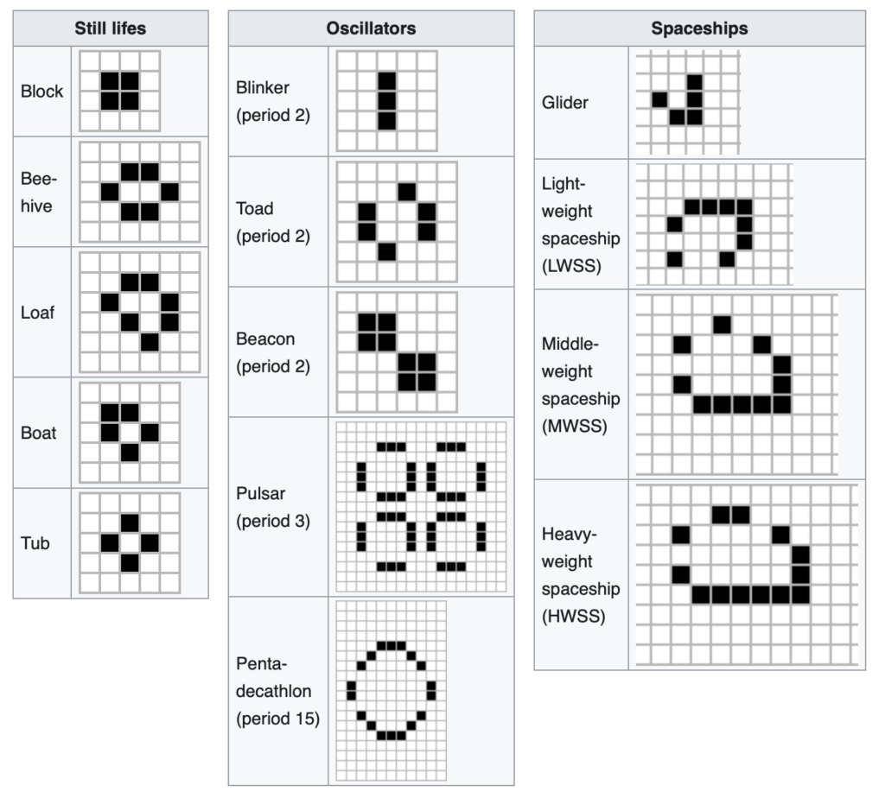
Evolution of structures Same rules, different outcomes
Still lifes: static patterns (e.g. 'beehive’)
oscillators: repeating patterns
spaceships: translating patterns (e.g. 'glider’)
guns: stationary patterns that emit spaceships
puffers: translating patterns that leave a trail of debris behind
Notes:
https://en.wikipedia.org/wiki/Conway%27s_Game_of_Life

Slide 52
Evolution of structures
the Gemini replicator: http://youtu.be/A8B5MbHPlH0
A whole library of structures is available at https://playgameoflife.com/lexicon
You can even setup Game of Life in the Game of life: http://youtu.be/xP5-iIeKXE8

Slide 53

Interactive - Quiz
https://www.menti.com/al3zaudxh84j
Notes:
With F=0.35 and 8x8, is there a possible state in which 60 agents are happy?

